Slide 1






Inspiring Bedfordshire to move more
beactivebeds.co.uk | @beactivebeds
Street Tag

Slide 2
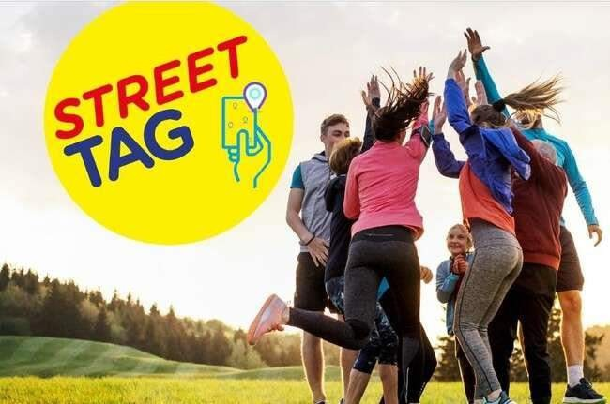


What is Street Tag?
Fun, free app that rewards you for exercising with prizes
Walk, run or cycle and collect tags to earn Street Tag points
Public Health Project: collaborating with community groups

Slide 3
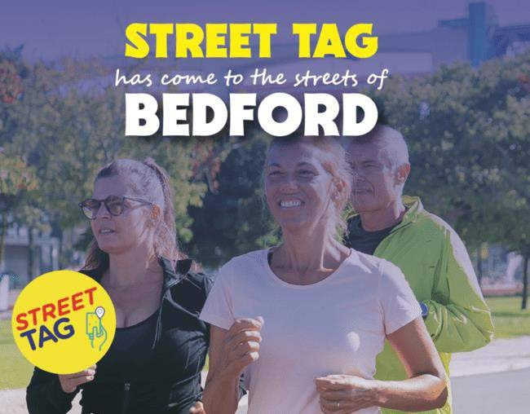
Benefits of Street Tag
Win amazing prizes
Improve mental and physical health
Explore local area/green spaces
Connect to the community and make long lasting friendships

Slide 4
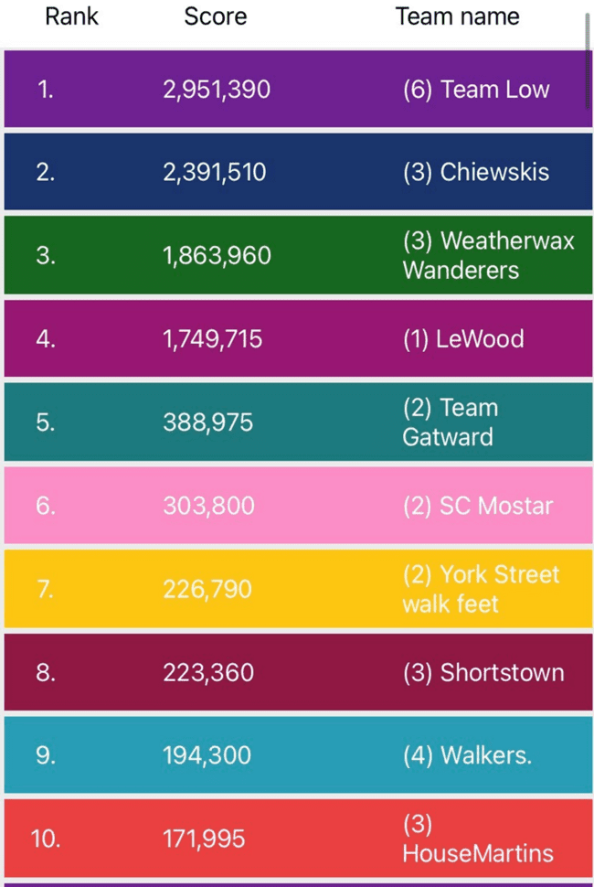
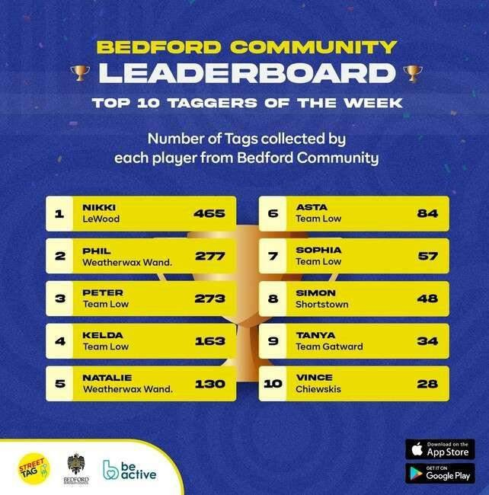
Community Leaderboard
Compete against other users in
Bedford Borough to see who can
collect the most tags and win
amazing prizes
Season 2: 15th Dec 23 to 18th April 24
Regular shoutouts and support
throughout
Over 400 community teams signed up to series 1 and 2

Slide 5


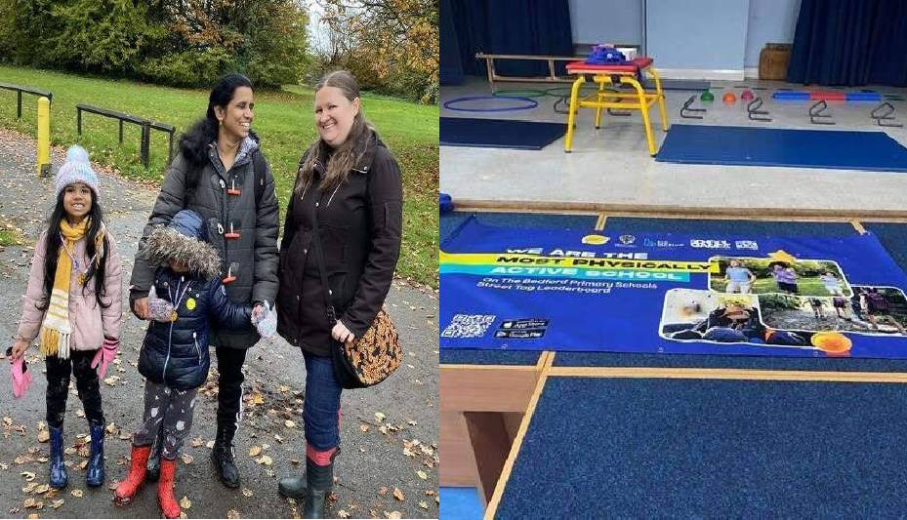



Primary School Leaderboard
Compete against other primary schools in Bedford Borough
Awards ceremony for winners
Schools can have up to 250 participants in your school team (these can include parents, children, staff, governors)
Virtual School Games
Season 2: 7th February to 5th June 24
Currently 18 schools signed up and over 500 Players

Slide 6
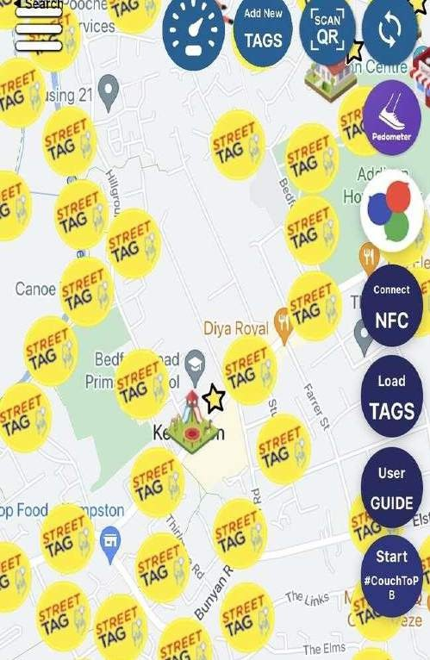
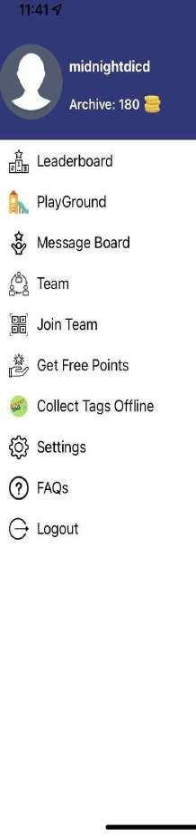
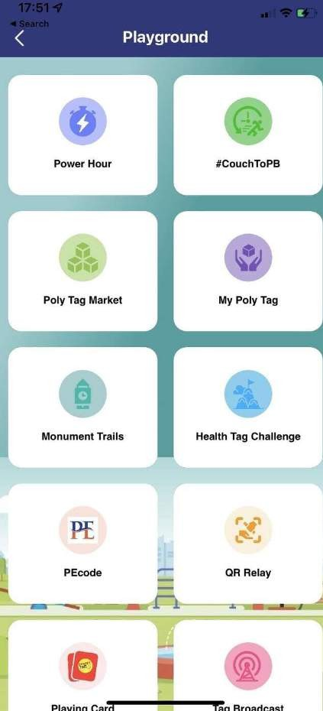
How It Works
App automatically scans tags in 40-meter radius
Tags are worth 50 points
and you can make teams
of up to 6 players
Steps can be converted into Street Tag points
The app can even sync with Fitbit devices.

Slide 7
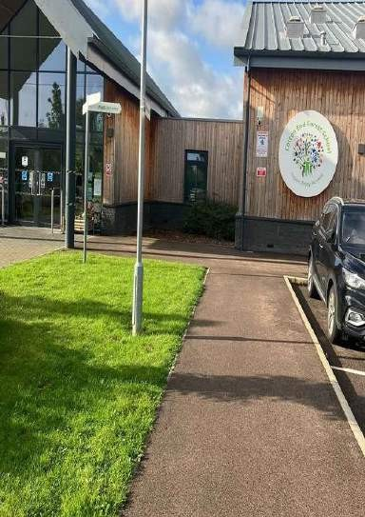
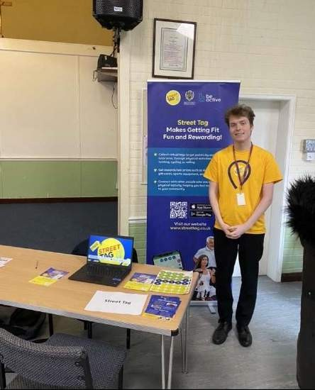
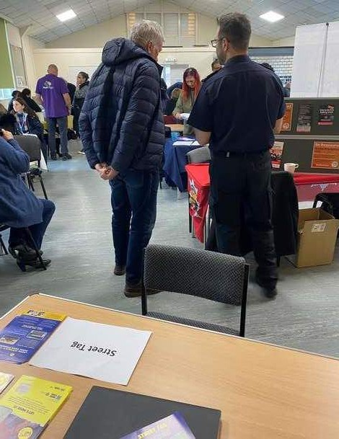
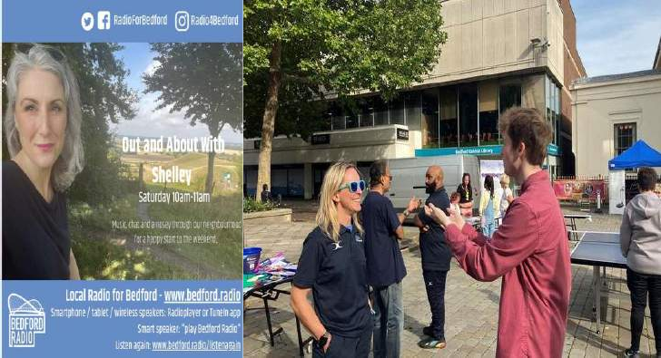
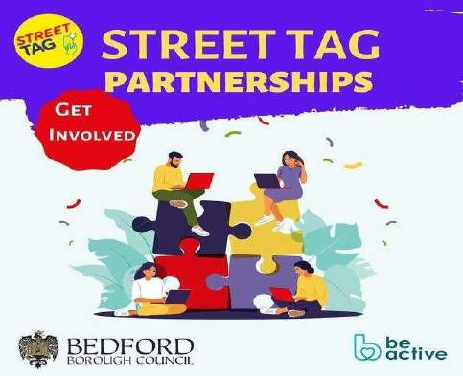


What We’ve been up to
Events and assemblies: World Mental Health Day, East Bedford Primary Care Network Drop- in Sessions and more
Partnership with Bedford Libraries
On the radio!
Street Tag Partnerships
Customization Ideas

Slide 8
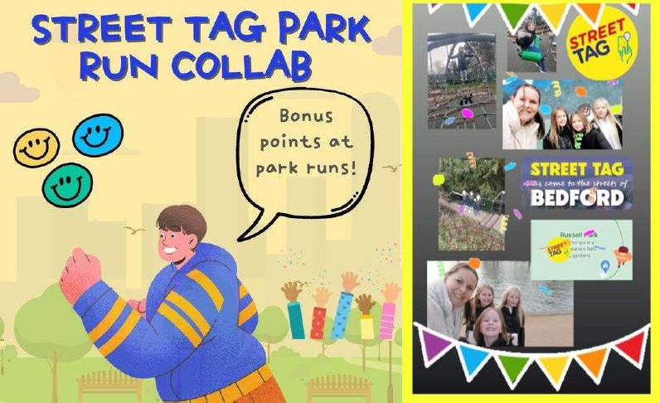
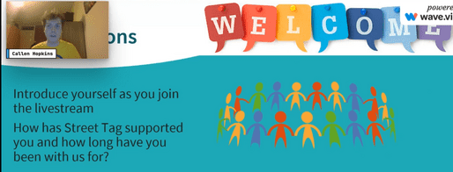

Community Engagement
Bi-Weekly livestreams: answering questions, giveaways and top tips!
Weekly Challenges on Social Media: Selfie challenge- take a picture at 3 monuments in BB for 1000 points!
Park Bonuses
Events: Riddle Challenges, QR Code relays etc.

Slide 9

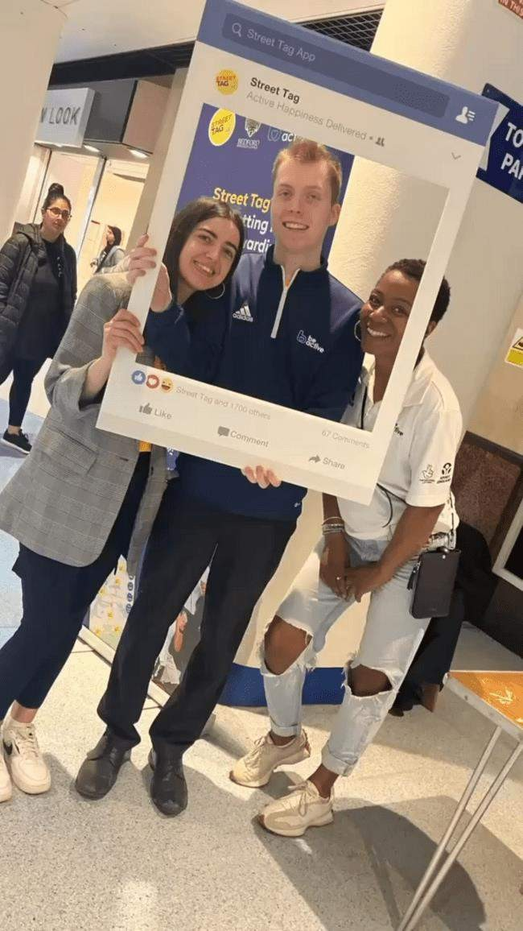


Slide 10
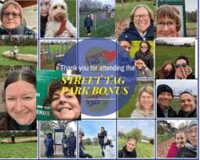
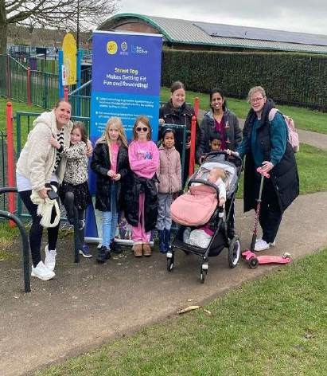
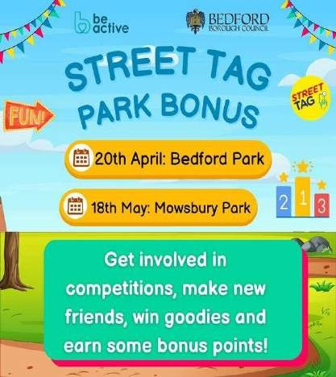
Monthly Park Bonus Sessions
Bring friends and family, explore our local parks and collect tags
Food to Share and special guests
Chance to Win bonus points!
Scavenger hunts, Quizzes, Tag frenzy and more!
Next date to be confirmed!

Slide 11

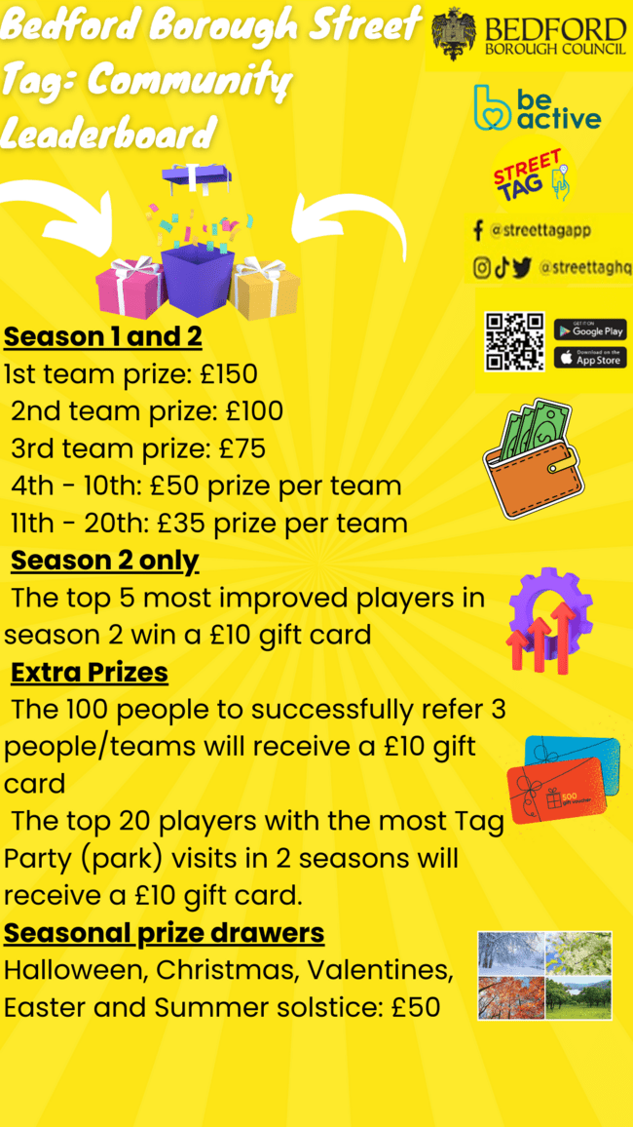

Prizes

Slide 12




Plans
Beds Govet Partnership- Educational Tags, story spots, special
events
Challenges on Social Media: Bingo activities Selfie Challenge and group VS and more
Upcoming events: One Percent Better, River Festival, Running
Festival and more

Slide 13
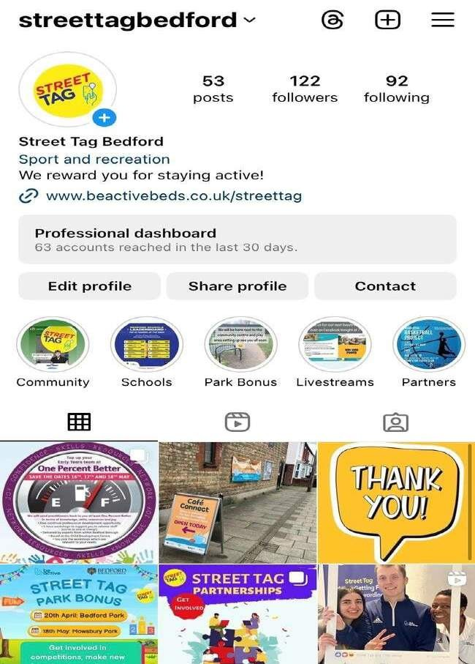





Stay in Touch
Instagram: StreetTagBedford
X: StTagBedford
TikTok: StreetTagBedford
Facebook: Street Tag Bedford
callen@beactivebeds.co.uk
07966 305448
Send testimonials to be featured- how ha Street Tag helped you etc. and stories of BB
Tag us and use #StreetTagBedford
s

Slide 14

How to Download
IOS and Android
Answer the survey
Click on Bedford Borough Leaderboard
Join a Primary School or Community Team or make your own.

Slide 15
Thankyou for Listening
Inspiring Bedfordshire to move more

