Slide 1
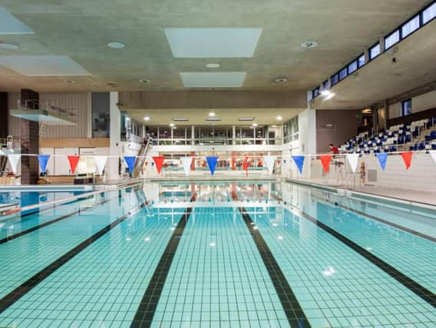

Bedford Borough Council
Mindful Sport

Slide 2

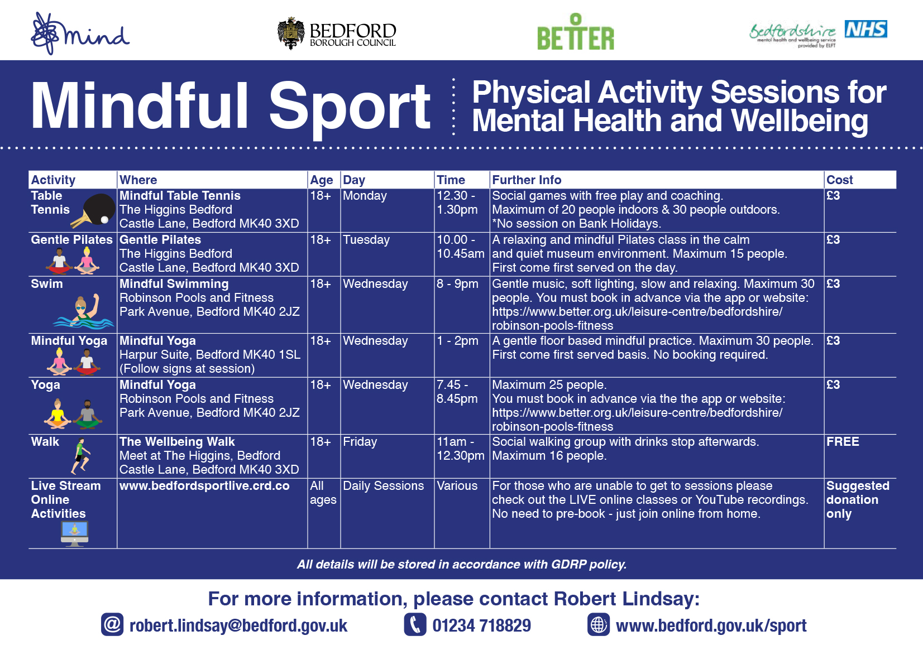

Slide 3
Participation
4016 attendances across 7 weekly Mindful classes
Notes:
Long-term goal to reduce inequalities, likely to take 20-30 years to achieve differences in life expectancy, but foundations for that change can be made now.
Most effective way to reduce inequalities is to focus on influencing building blocks of health with partner organisations.

Slide 4
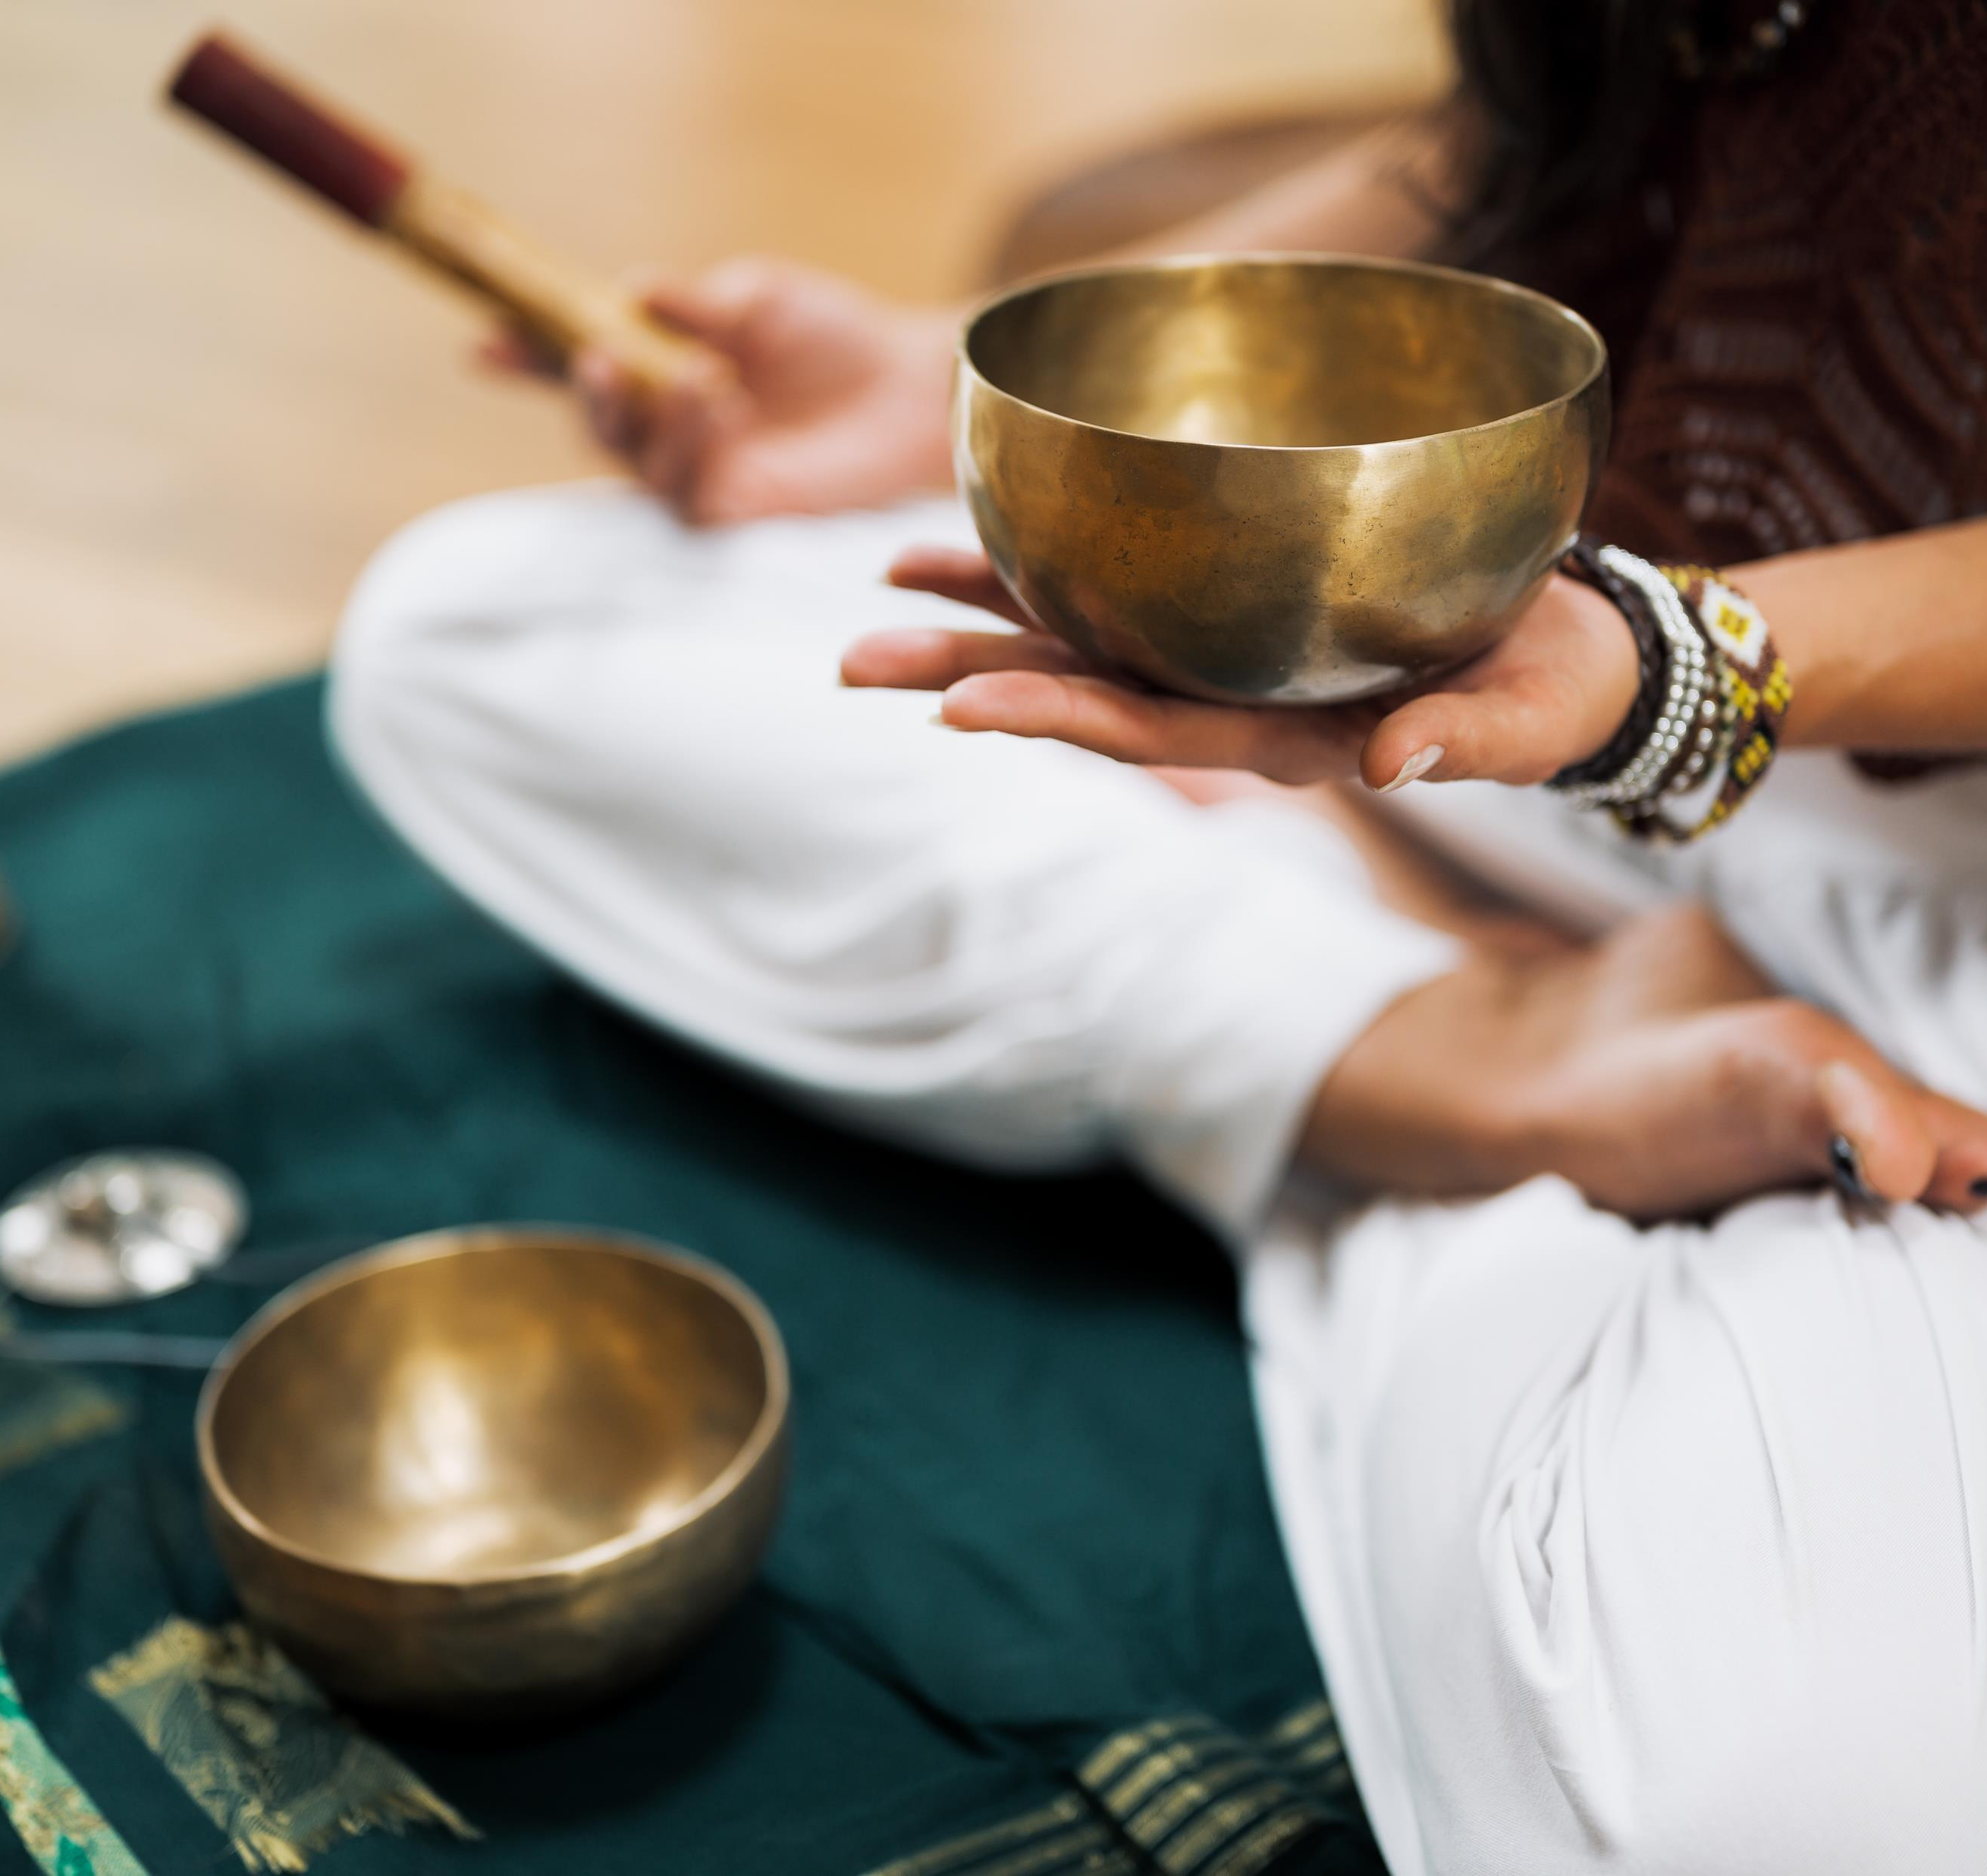
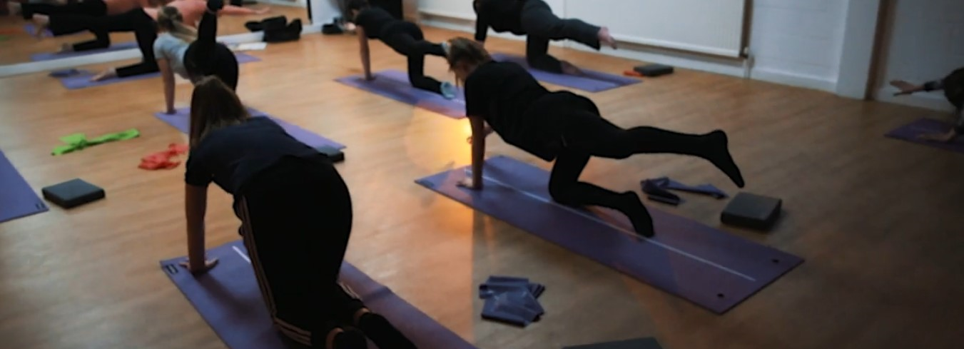
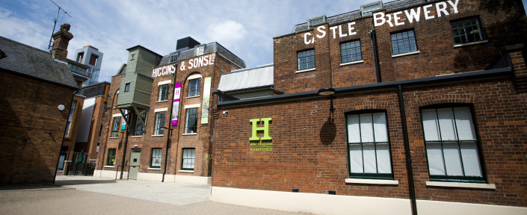
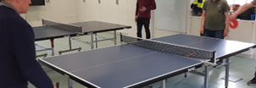
Building a support network
Total attendances 4016 – the wide range of informal sessions allows for people to find regular and ensuring classes that they can drop into anytime.

Slide 5
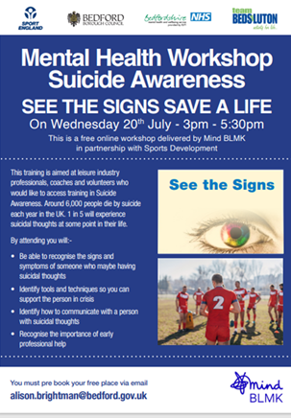
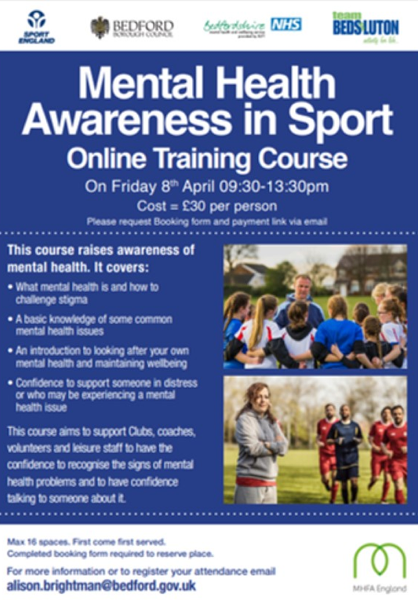
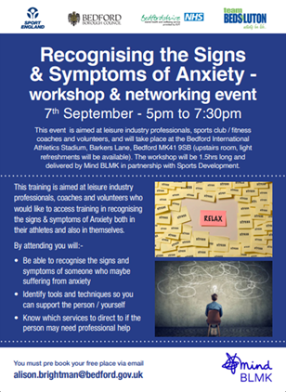

Slide 6
Online classes
Chair Yoga
Chair Dance
Chair Cycling
Jane’s gentle exercise
Janes Chair based exercise and Parkinson’s support
Notes:
Best start in life will be taken forward through existing meetings and governance structures
My role – to support and attend 4 of the groups to provide oversight, avoid duplication and ensure work is joined up when required.
The Senior Officer, Public Health Children & Young People, will oversee the implementation of the ‘Best start in life’ building block of health.
Co-chairs will meet with
Employment, skills and workplace health implementation group met 20 February
Healthy Homes meeting scheduled for 6 March

Slide 7
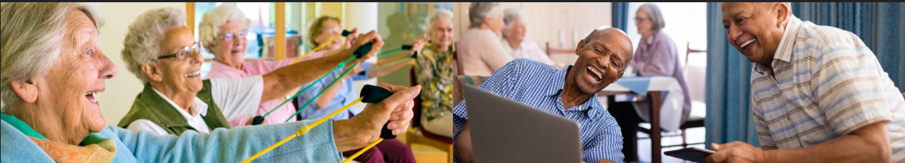
engAGE online sessions
Jane welcomes 60 online attendances on average across 3 weekly live stream sessions.
Regular care home attendees include: Sir William Harpur, Elstow manor & Elcombe house.

Slide 8
Mindful Sport objectives 2024-25 and the future Bedford provision:
Continuing to work closely with the Lifestyle Hub, GLL, Mind BLMK, East London Foundation Trust/Recovery College to ensure that there a pathway from in-patients/GPs into Mindful Sport.
Ensuring that Mindful Sport sessions promote peer to peer support and therefore offer an early intervention and preventative measure of poor mental health.
Continuing to ensure that staff, coaches and volunteers are upskilled in mental health first aid and are aware of signposting and referral routes for clinical services.
Working with CHUMS and GLL to develop a new class for young adults.

Slide 9
