Slide 1



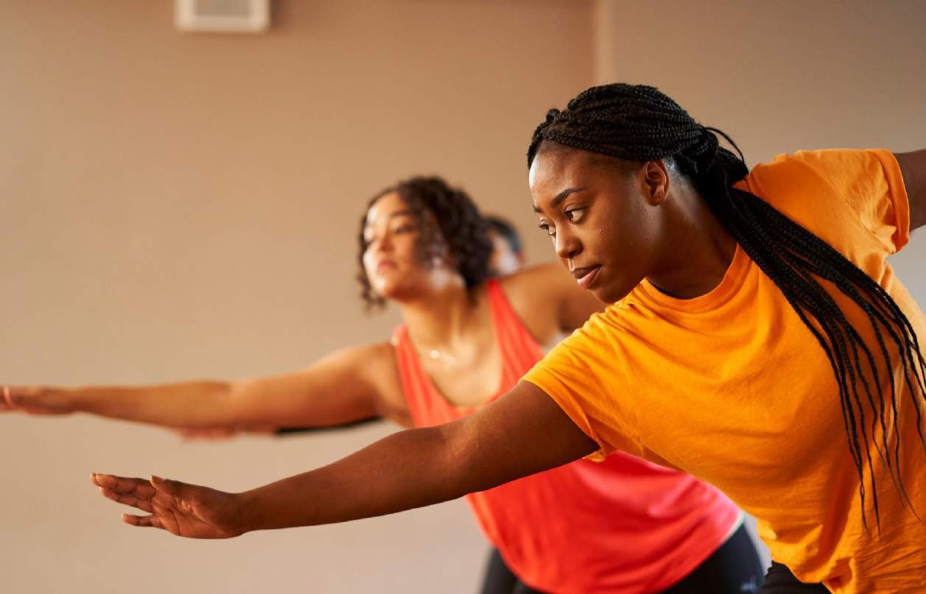

Inspiring Bedfordshire to move more
Physical Activity & Mental Health
beactivebeds.co.uk | @beactivebeds

Slide 2
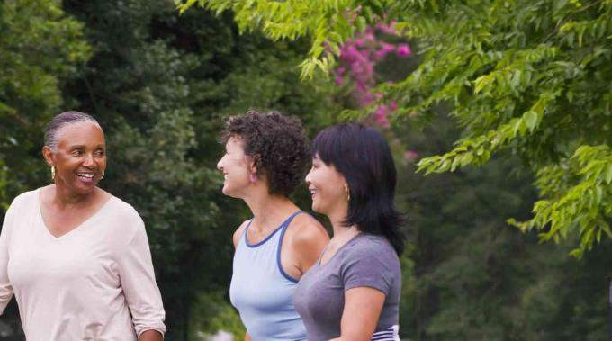



Our Vision
A Healthier, Happier Bedfordshire
beactivebeds.co.uk | @beactivebeds

Slide 3
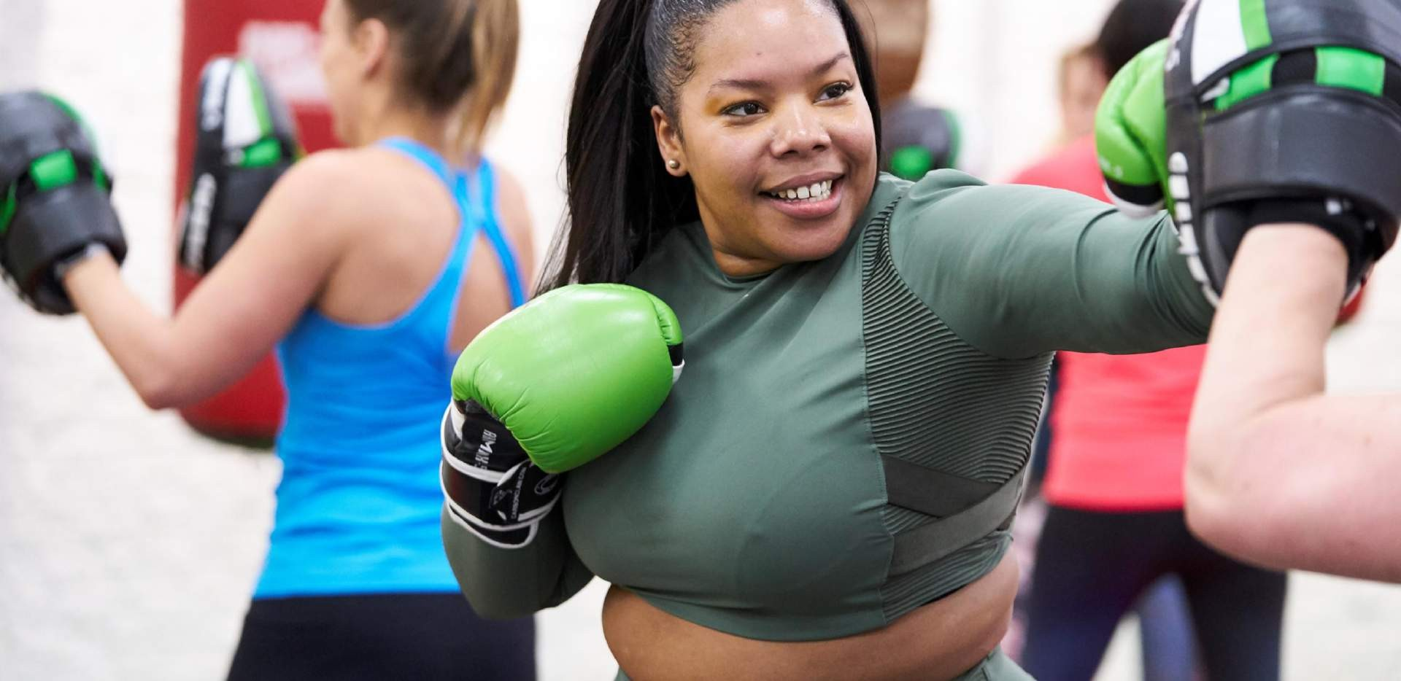

Sport England Relationship
We're one of over 100 system partners funded by Sport England to help deliver their strategy Uniting the Movement.
As one of these system partners we play a connecting, influencing and governing role within the sport and physical activity sector.
Our role is to create the conditions for positive change to help more people engage and reap the benefits of getting active.
We work collaboratively with organisations both in and outside of the sector, who are committed to tackling the inequalities that currently exist and will help more people from under- represented groups become active.
beactivebeds.co.uk | @beactivebeds

Slide 4

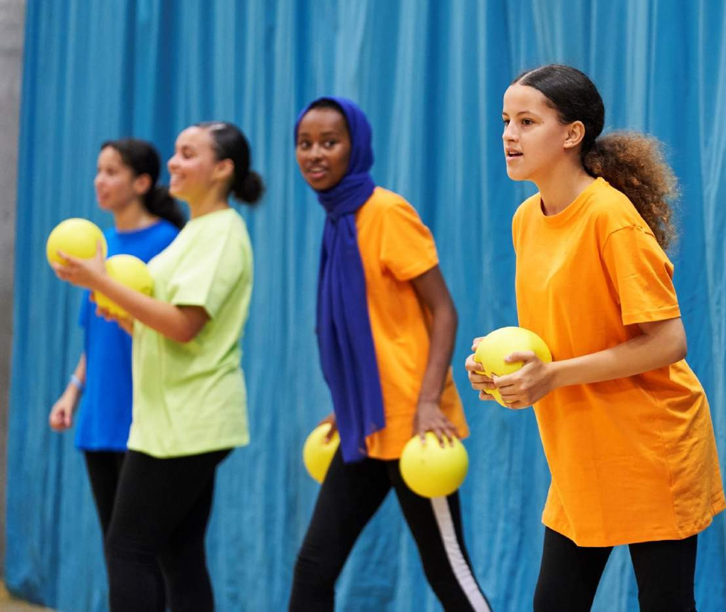
Our Strategy-
Moving Forwards Together
Mission: To work in partnership to support, develop and promote opportunities for people to be active for life.
We will raise the profile of physical activity as a tool to improve lives, create inclusive, safe opportunities and build community resilience.
We will influence and support the system to ensure that
physical activity is part of the solution.
We will support, inspire, and empower our communities.
beactivebeds.co.uk | @beactivebeds

Slide 5

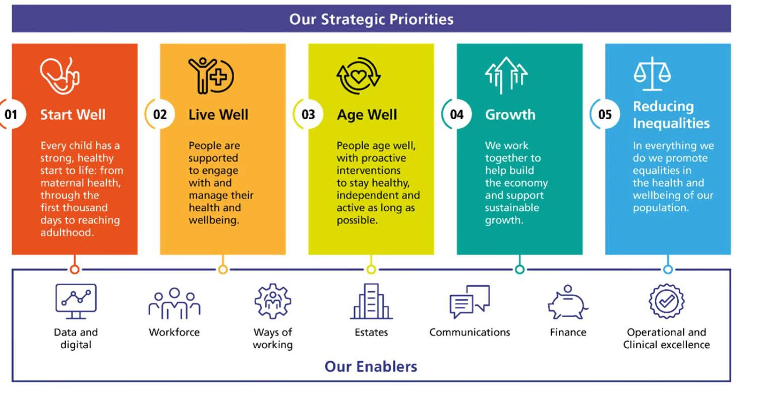
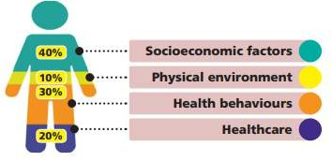
Our Strategy & how it aligns with BLMK priorities
We have four main workstreams:
People & Place
Children & Young People
Active Environments
Health & Inequalities
beactivebeds.co.uk | @beactivebeds

Slide 6
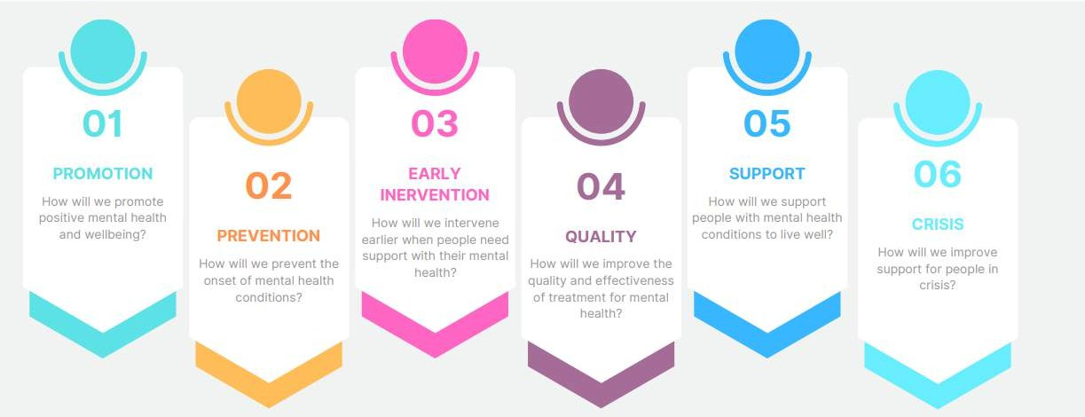
Contributing to the Ten year MH plan
beactivebeds.co.uk | @beactivebeds

Slide 7

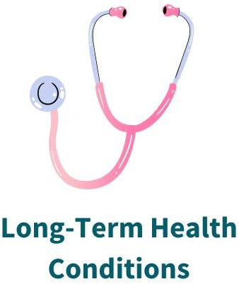
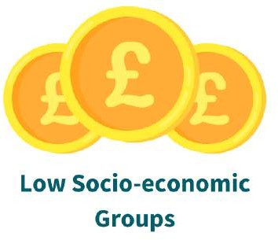
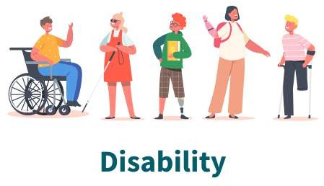
Our Key Audiences
beactivebeds.co.uk | @beactivebeds

Slide 8
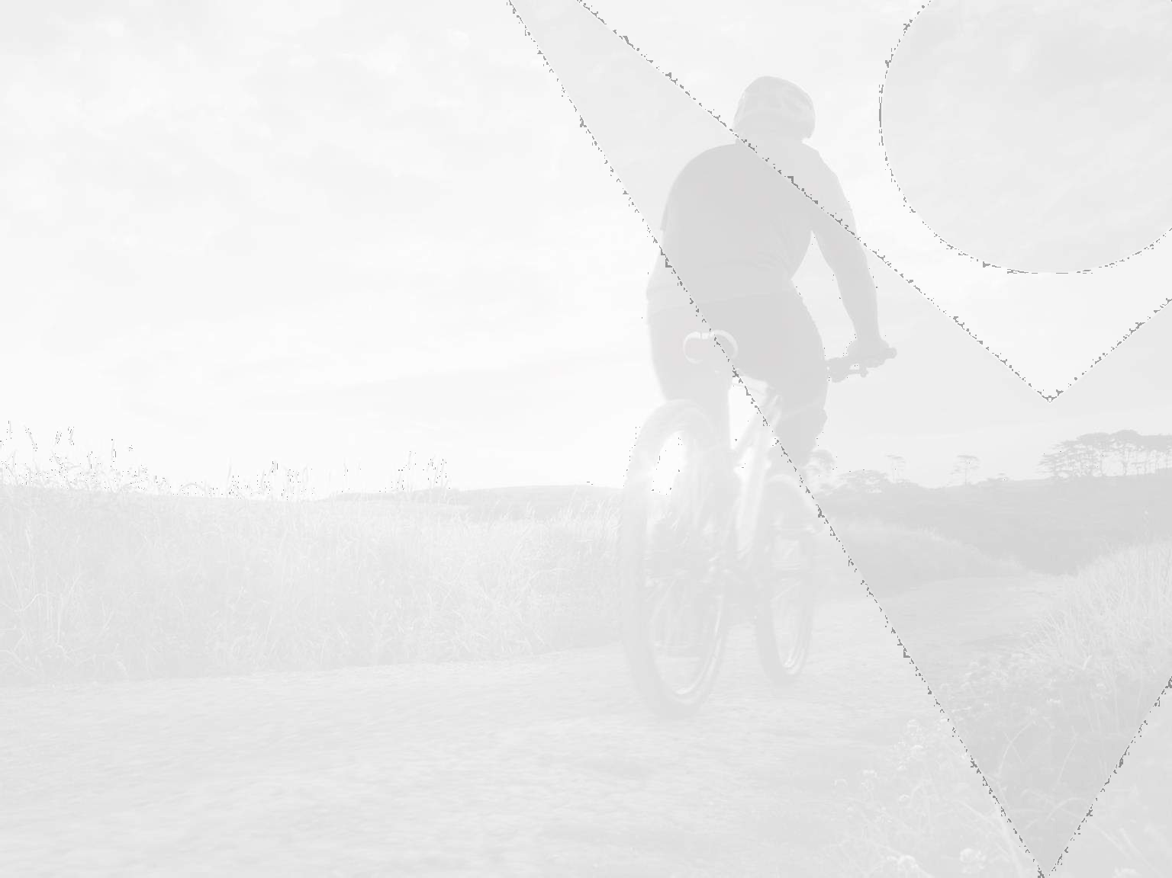

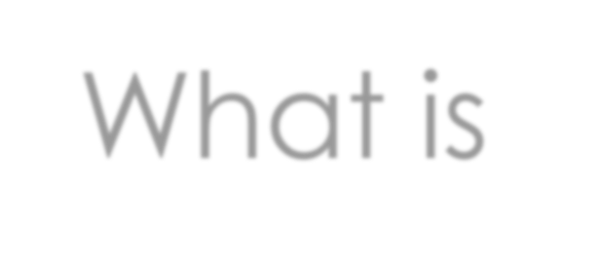
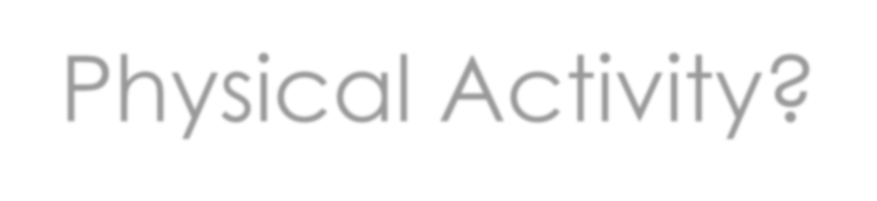
What is
Physical Activity?

Slide 9
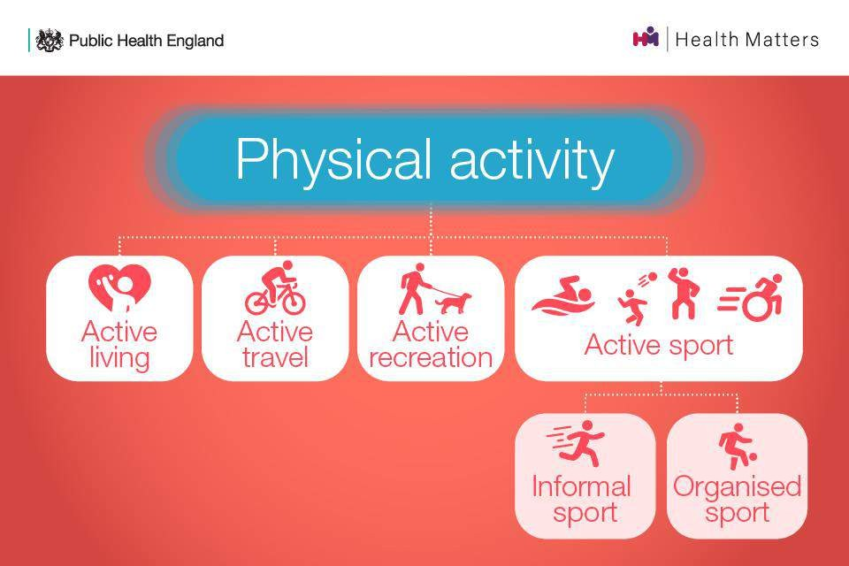
What is Physical Activity?
Source: Public Health England, 2020

Slide 10
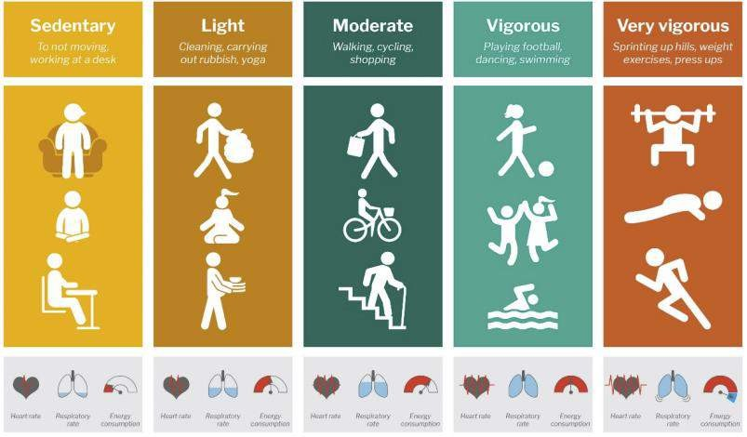
Different Intensities
Source: Department of Health & Social Care, 2019

Slide 11
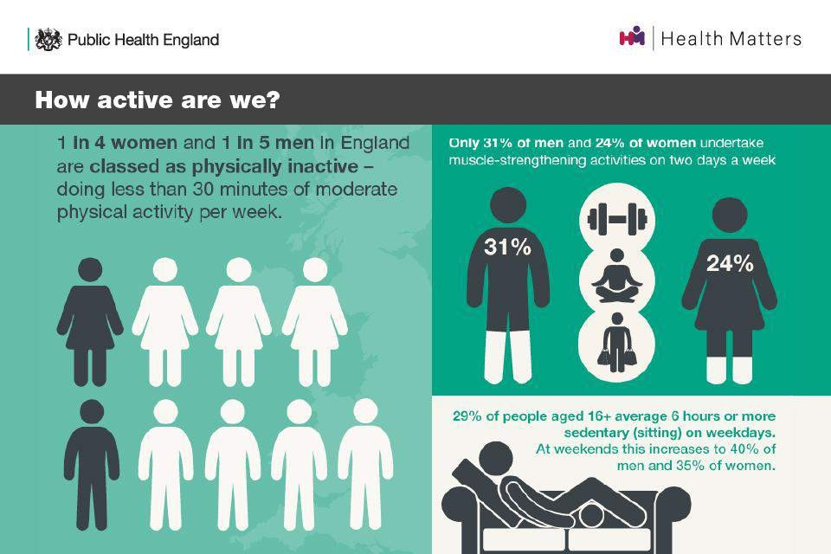
How active are we?
Source: Public Health England, 2020

Slide 12
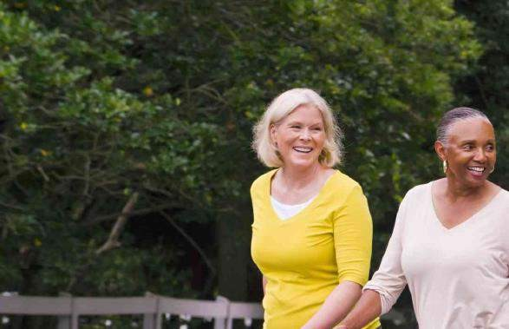
Physical Literacy
Physical Literacy is our relationship with physical activity throughout our life. It refers to the degree to which we have a positive and meaningful relationship with movement and physical activity. It is a complex and ever changing relationship that is very personal and always unique to each of us.
Activity Levels
Age
beactivebeds.co.uk | @beactivebeds

Slide 13
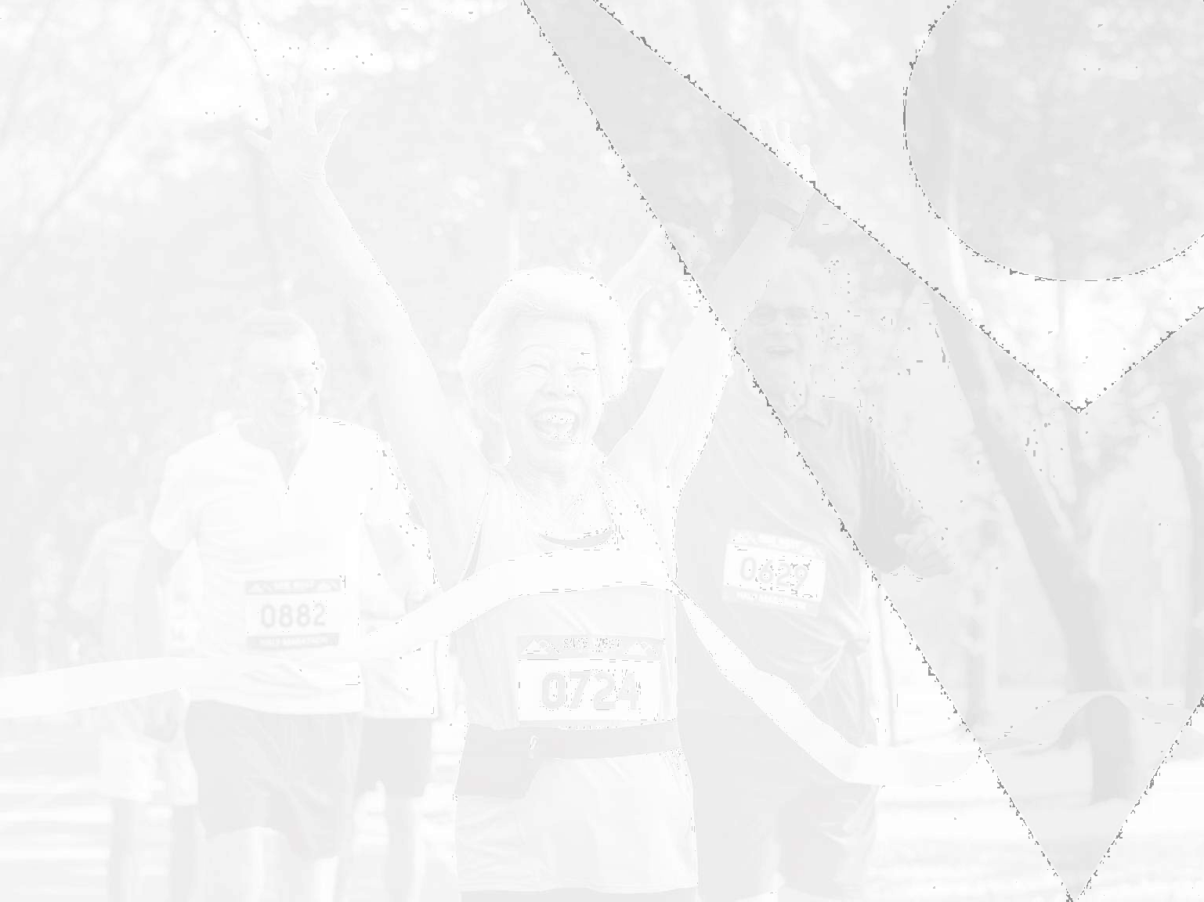


What are the Benefits of Physical Activity?

Slide 14
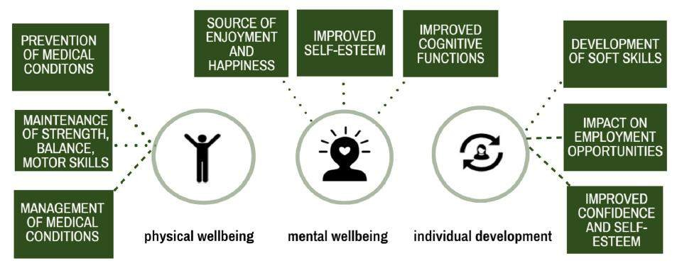
Role and Benefits of Physical Activity
Source: Public Health England, 2020

Slide 15
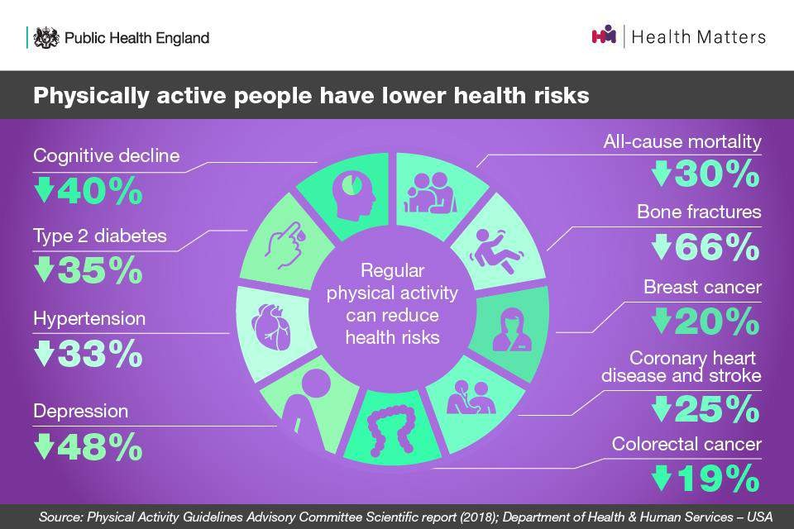
Physical Activity and Health
Source: Public Health England, 2020

Slide 16
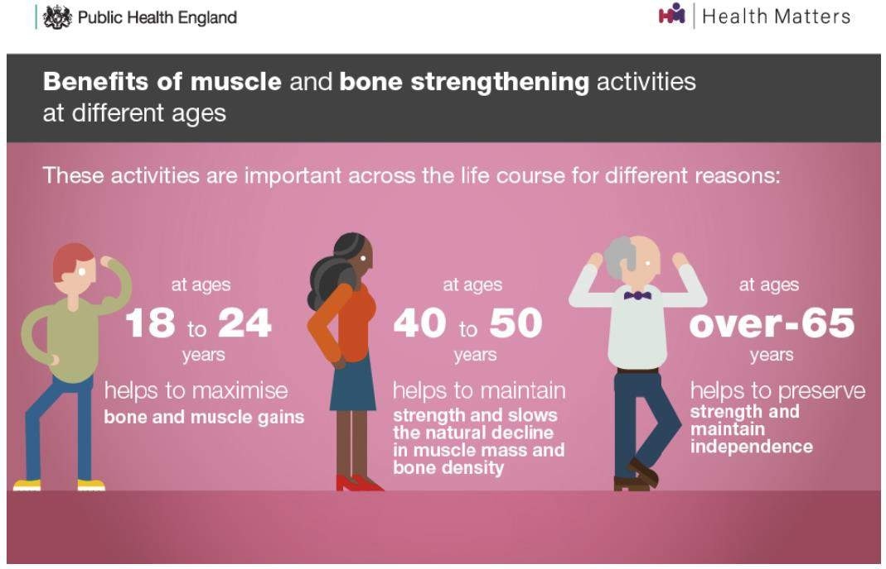
Strength and Balance
Source: Public Health England, 2020

Slide 17
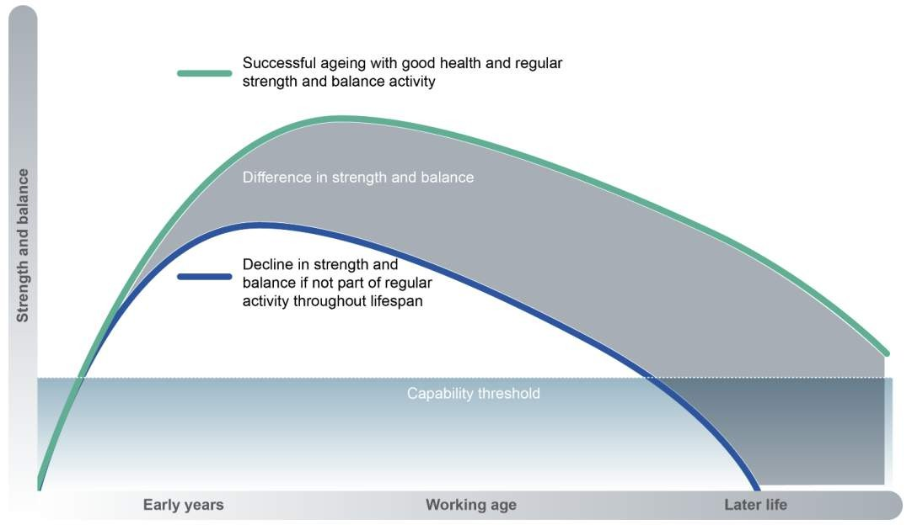
Strength and Balance
Source: Department of Health & Social Care, 2019

Slide 18
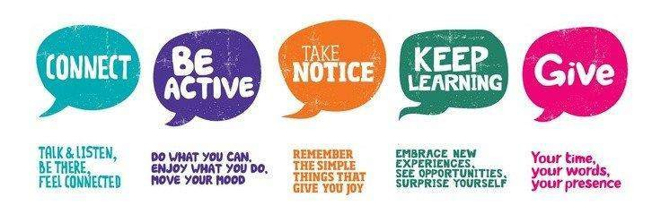
The Five Ways to Wellbeing
Source: New Economics Foundation, 2008

Slide 19

If physical activity were a
drug, we would refer to it as
a miracle cure, due to the
great many illnesses it can
prevent and help treat
UK Chief Medical Officers, 2019

Slide 20
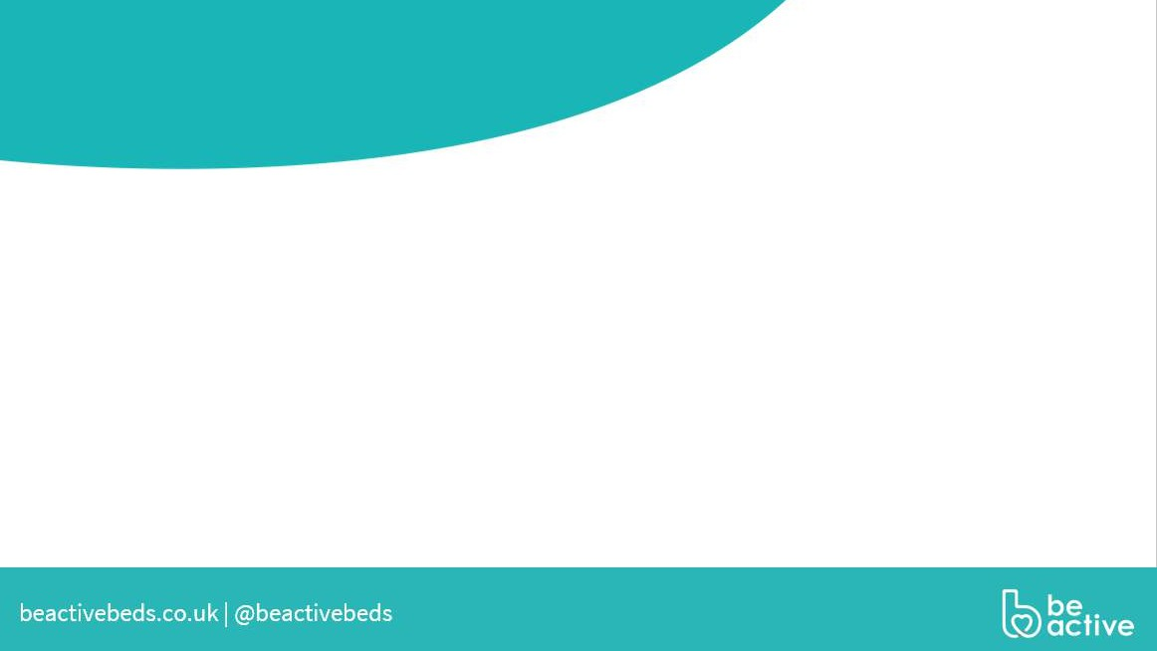

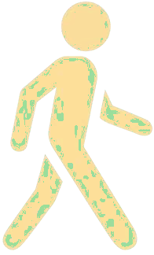

How can physical activity support the improvement of mental health
Relieve symptoms of stress
Those who took part within a group setting reported better experiences and feeling more motivated to participate (Mind and Loughborough University)
Increase self-
esteem
Improve mood
Taking part in regular physical activity can lower the risk of depression by up to 30% (NHS- Live Well)
How physical activity can improve well-being and mental health (Rethink)
Improving sleep patterns
Releasing hormones like endorphins to make you feel good
“ A 10-minute brisk walk, can increase our energy levels, boost mood and help us interrupt racing thoughts.” (Mind)
Feeling confident

Slide 21



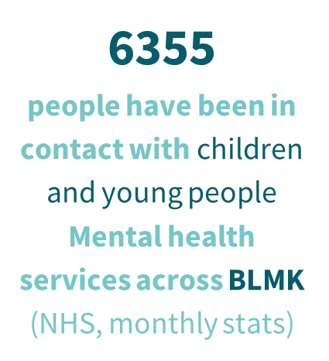
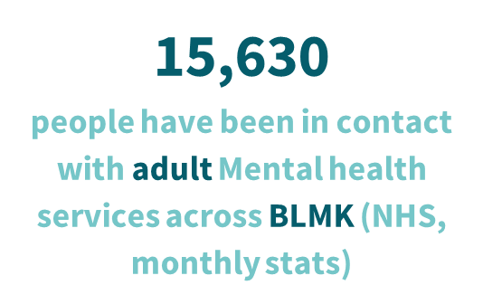
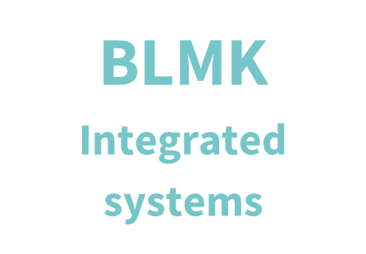
Current landscape across Bedfordshire
n
63.6%
of adults in Central Beds are physically active
(Active Lives Survey 21/22)
This has increased since last year
Central Bedfordshire
41.8%
63.6%
of adults in Bedford Borough are physically active
(Active Lives Survey 21/22)
of children and young people in Luton are considered active (Active Lives Survey 22/23)
47.0%
of children and young people in Central Beds are considered active (Active Lives Survey 22/23)
This has decreased since 21/22
Bedford
Luton
55.6%
of adults in Luton are physically active
47.5%
of children and young people in Bedford Borough are considered active (Active Lives Survey 22/23)
This is down from the previous year
(Active Lives Survey 21/22)

Slide 22
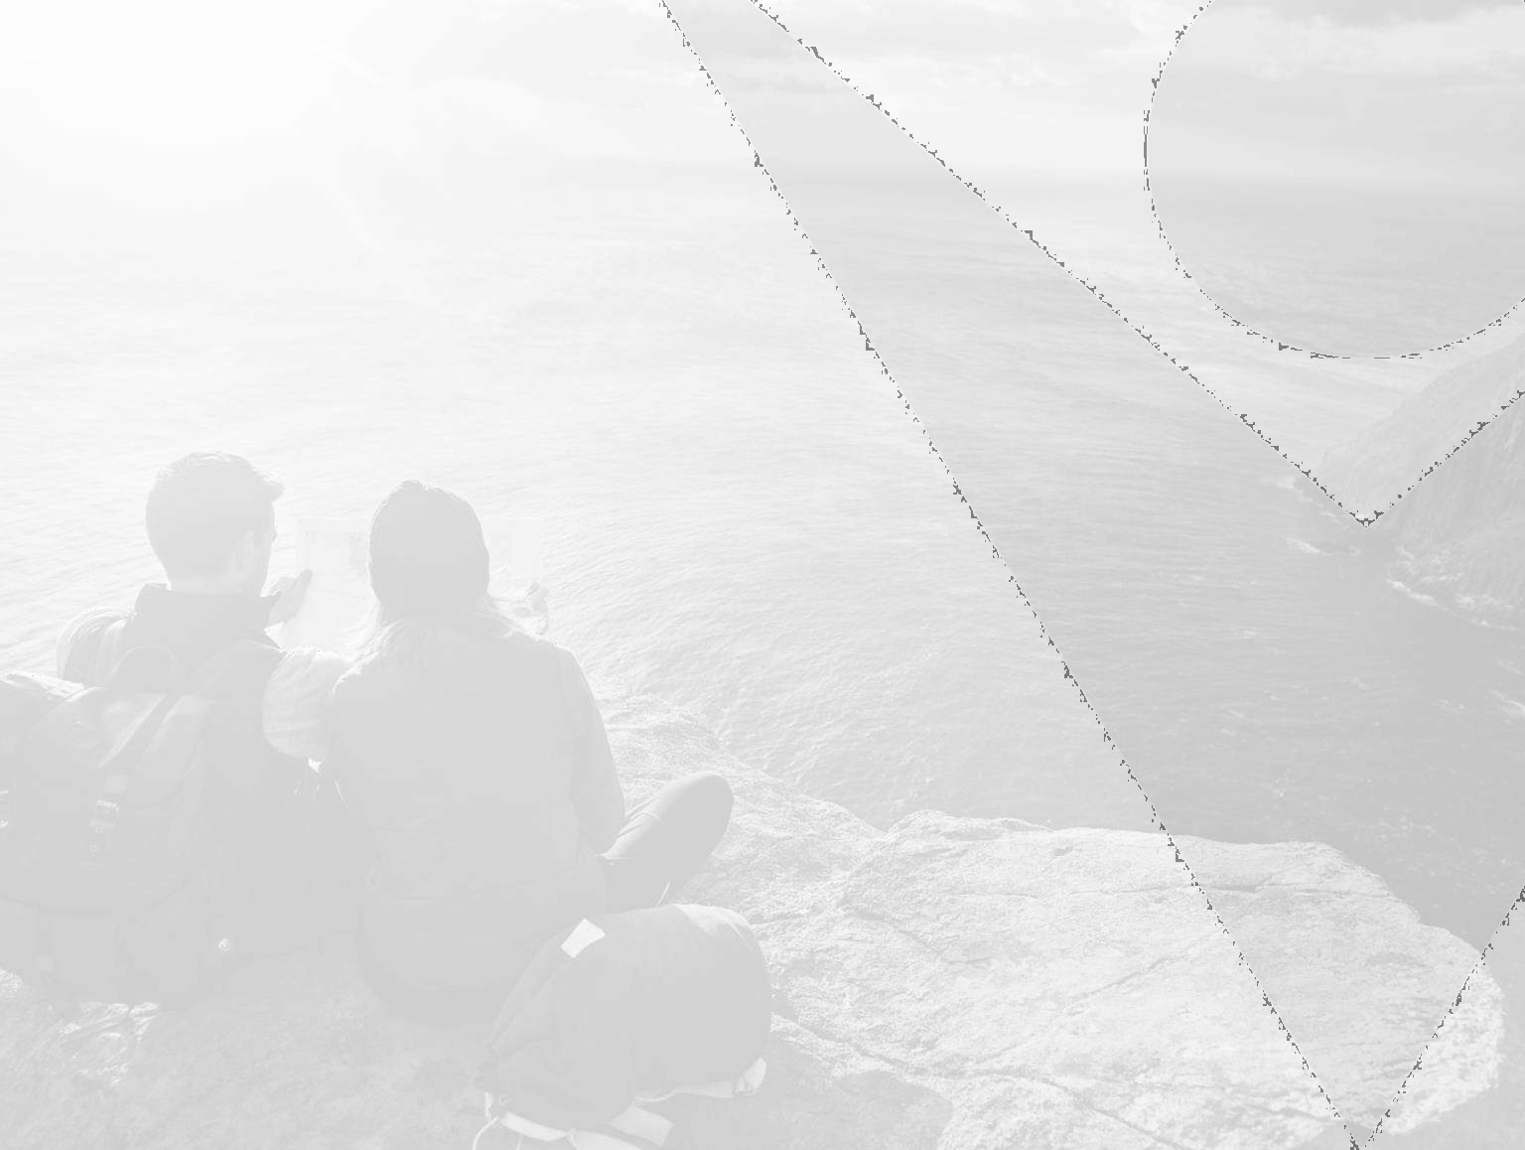


National Signposting

Slide 23
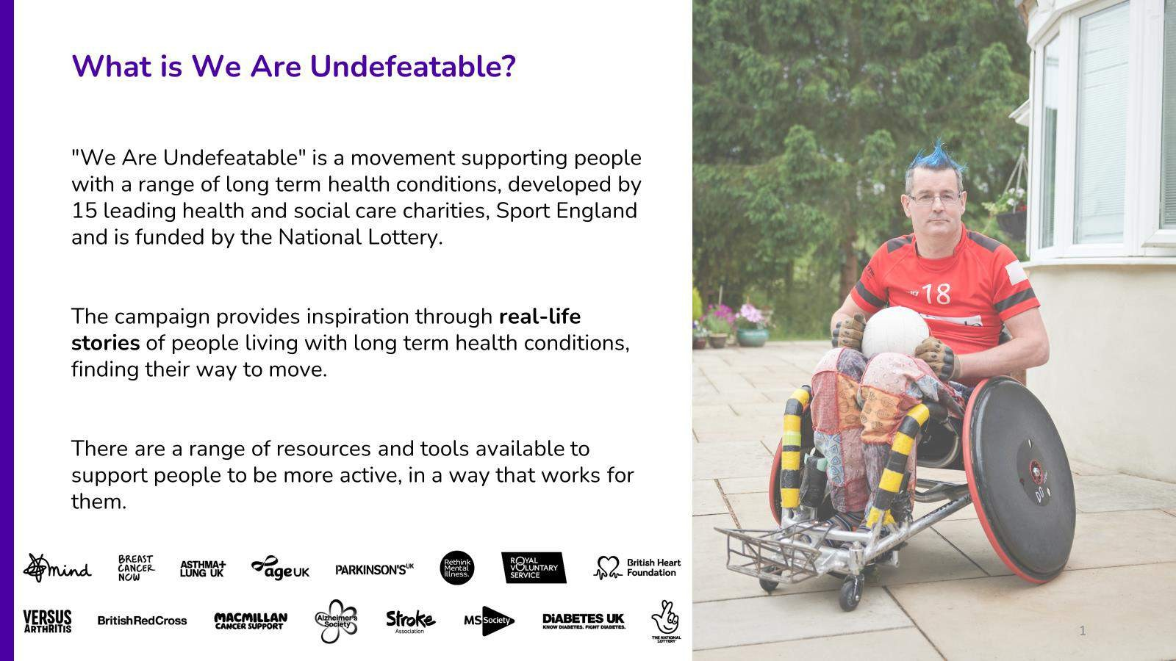
beactivebeds.co.uk | @beactivebeds

Slide 24
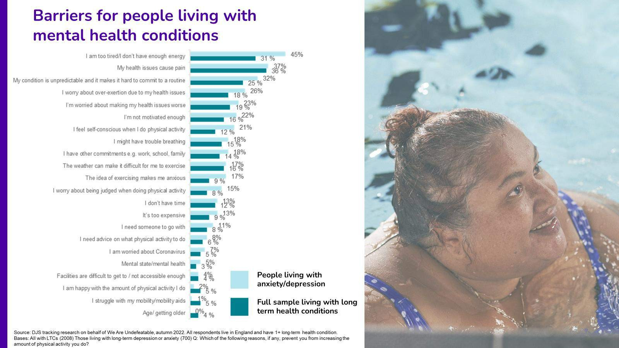
beactivebeds.co.uk | @beactivebeds

Slide 25
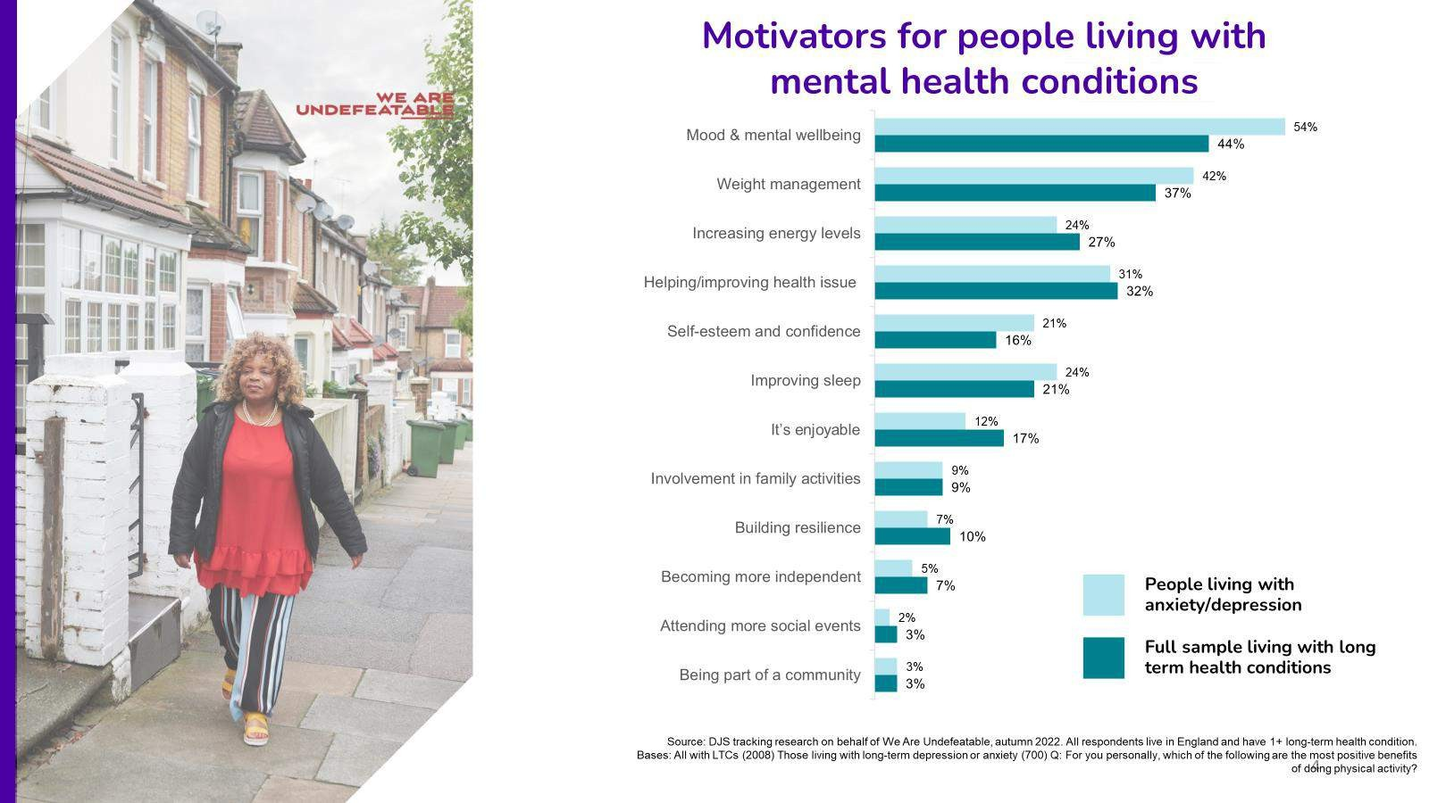
beactivebeds.co.uk | @beactivebeds

Slide 26
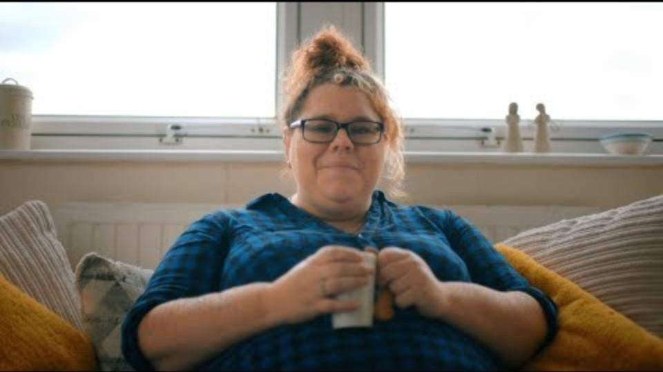
beactivebeds.co.uk | @beactivebeds

Slide 27
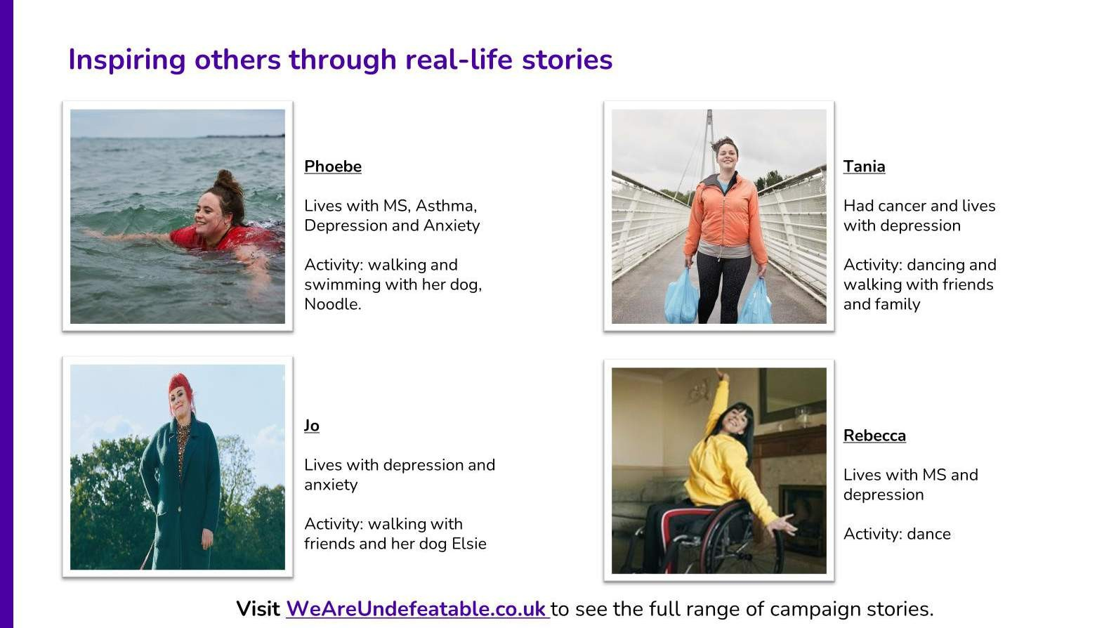
beactivebeds.co.uk | @beactivebeds

Slide 28


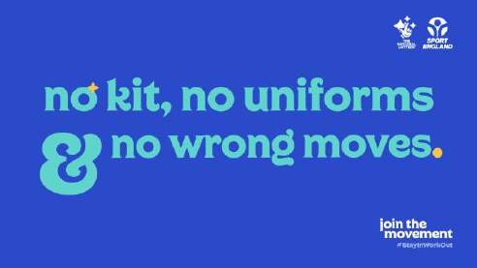
Join The Movement
A campaign launched by Sport England in response to lockdown during the Covid-19 pandemic
Advice on being active in and
out of the home for all abilities
Includes:
Get active at home
Get active away from home
Get active with the kids
Fitness Challenges
https://www.sportengland.org/jointhemovement

Slide 29
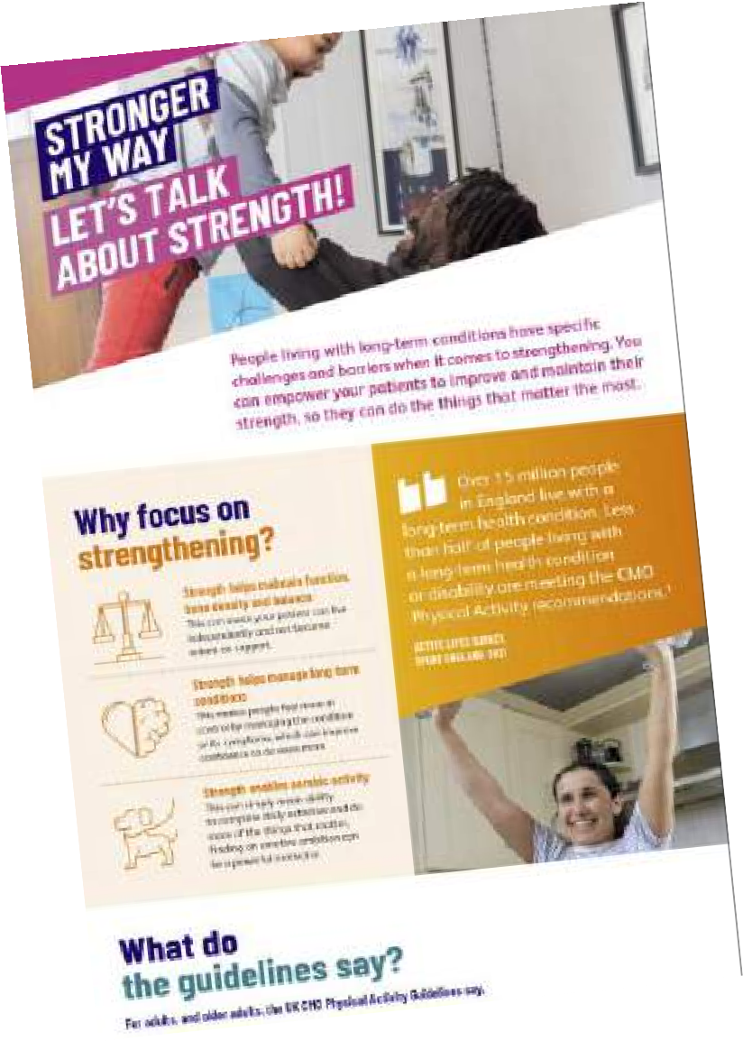
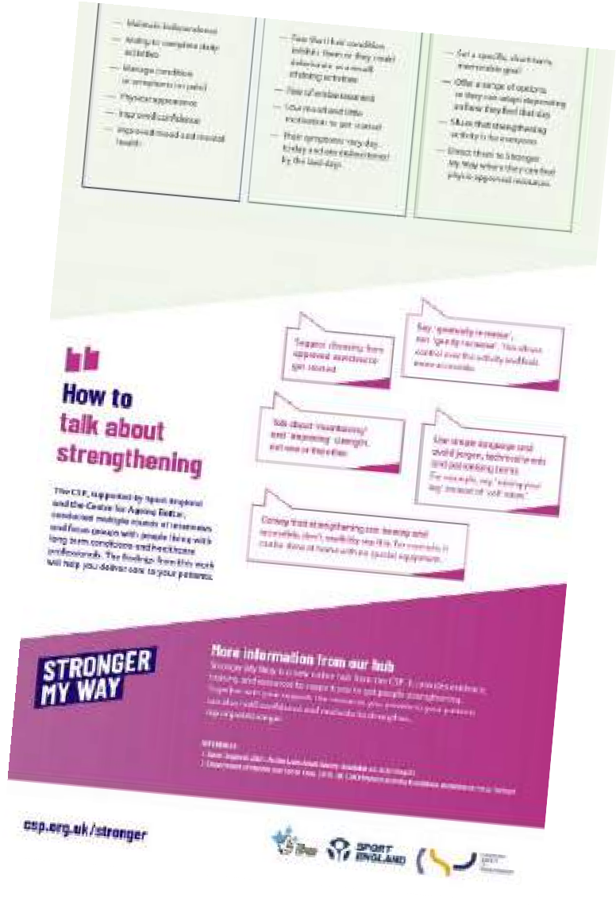
Stronger My Way
New online hub from the Chartered Society of Physiotherapy.
Provides evidence, training and resources to support people getting stronger.
For professionals - evidence base, links to training and resources, and a forum to share information and experiences.
For the public - videos, supporting resources and stories about people living with health conditions.
https://www.csp.org.uk/campaigns-influencing/campaigns/stronger-my-way

Slide 30
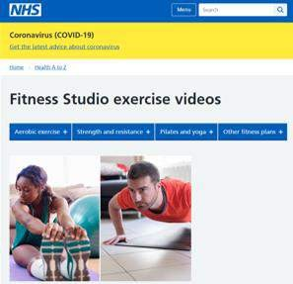
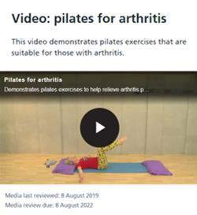
NHS Fitness Studio
The NHS is a trusted source of information. This page includes a range of online exercise videos.
Workouts for older adults, seated exercises, arthritis, MS, osteoporosis and back pain
Includes:
Advice and guidelines
Workout and fitness plans
Equipment-free and 10-min workouts
Illustrated 1-page workouts (printable)
https://www.nhs.uk/conditions/nhs-fitness-studio/

Slide 31
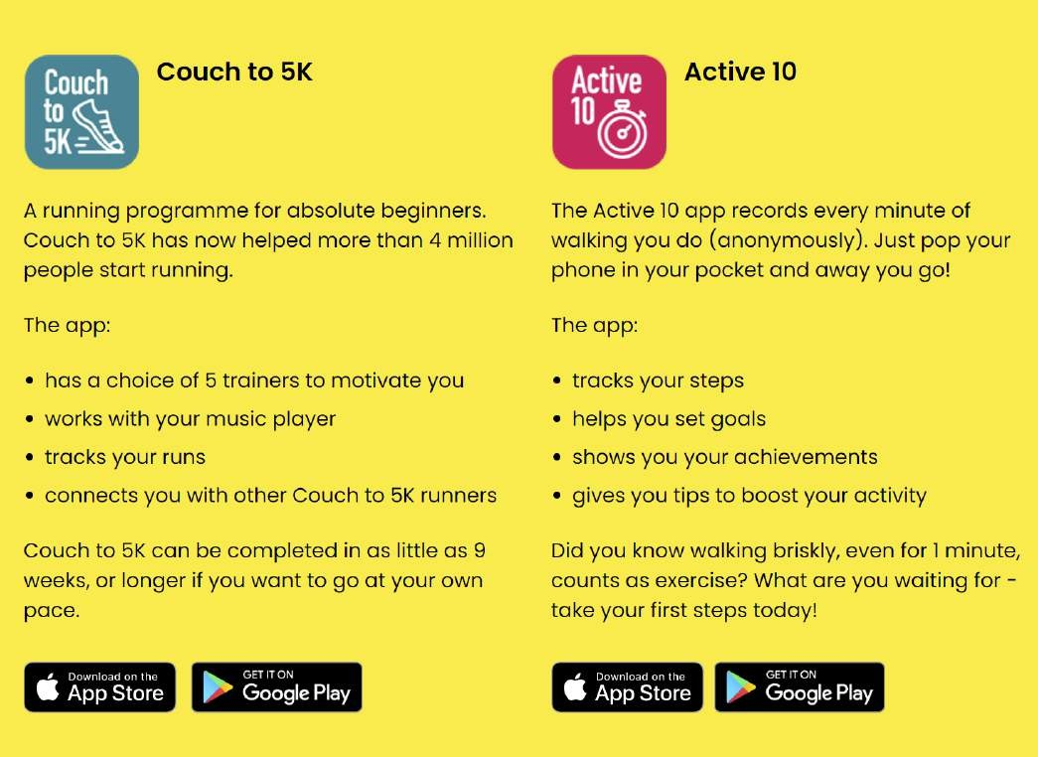
Apps

Slide 32
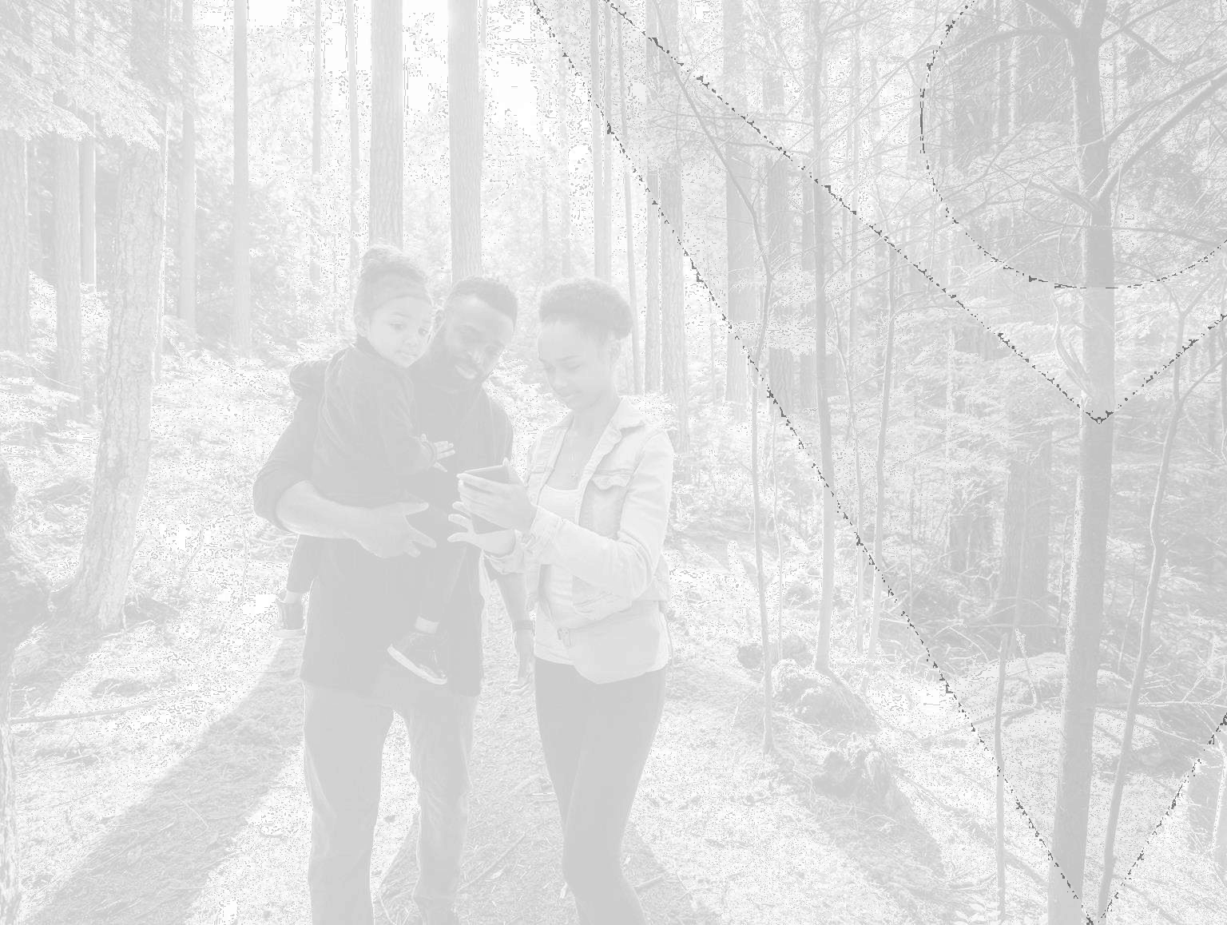

Local Signposting

Slide 33

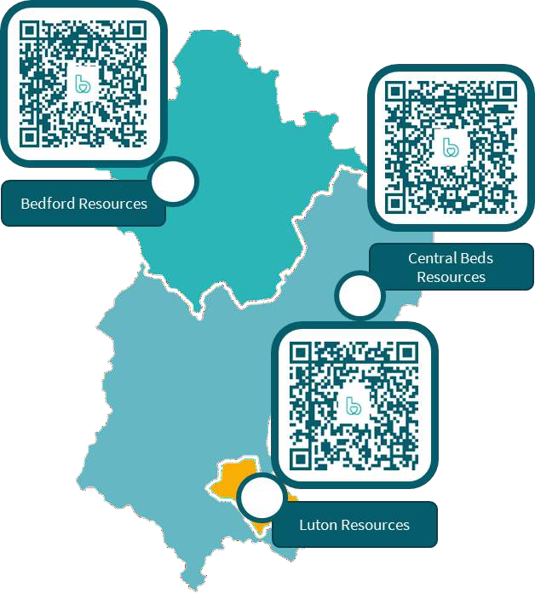
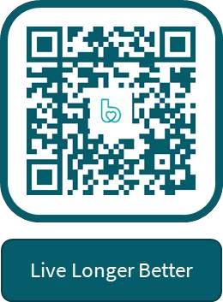
Local Signposting
Bedfordshire and Luton

Slide 34
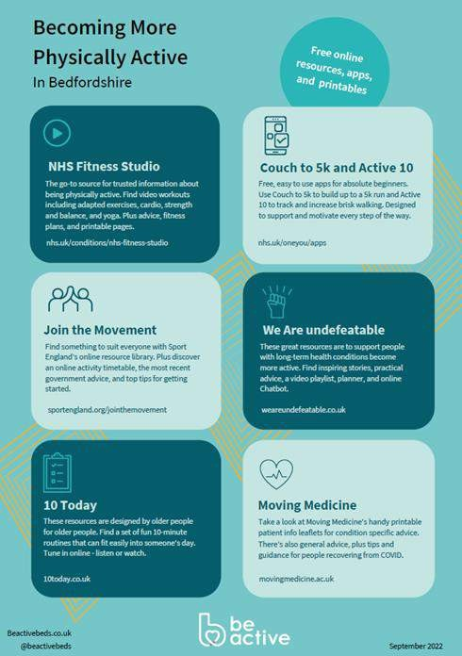
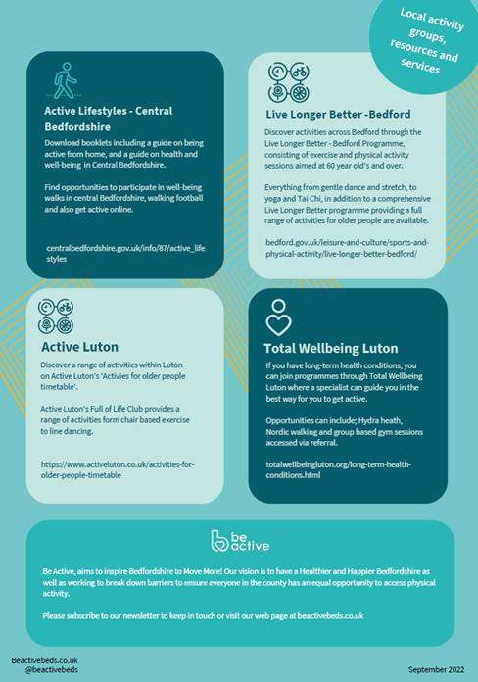
Local Signposting
Bedfordshire and Luton

Slide 35
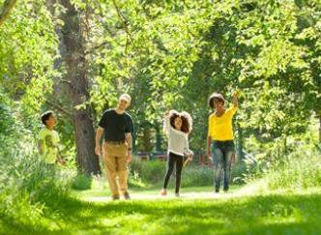
Local Signposting
The Great Outdoors
Don’t forget about outside space & green spaces! Like …
Local Parks & Gardens
Country Parks
Family Friendly Cycling Routes
Walking trails
Community Allotments
Active Travel e.g., walking or
cycling to school or work

Slide 36




How can we work together?
We are a fully funded service that provide our core workstreams free of charge.
Providing training and awareness building of the benefits of physical activity and wellbeing. (Active Medicine & PACC)
Creating tangible resources that can be used by your teams to help people
to increase their levels of physical activity in an affordable and sustainable way.
Working with partners to secure resources and investment that will improve the health and wellbeing of Bedfordshire
Working with you to better understand the issues and barriers that your patients face in accessing opportunities to be physically active.
beactivebeds.co.uk | @beactivebeds

Slide 37
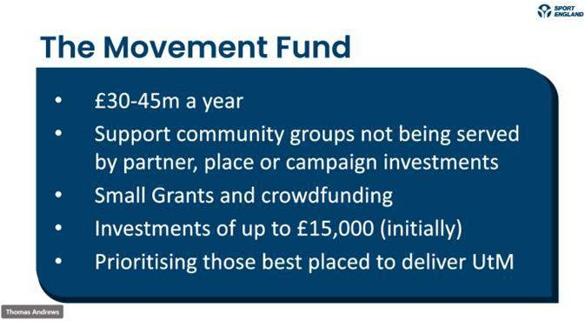

Slide 38
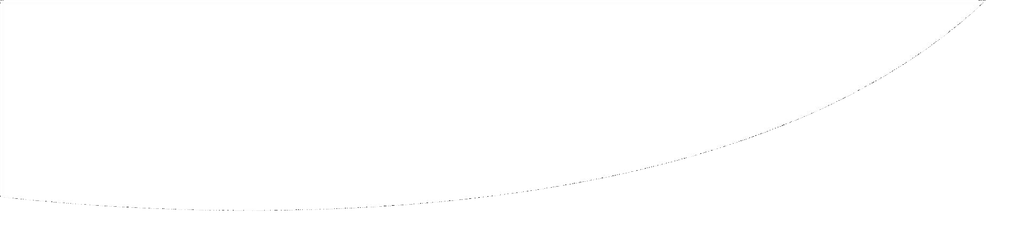
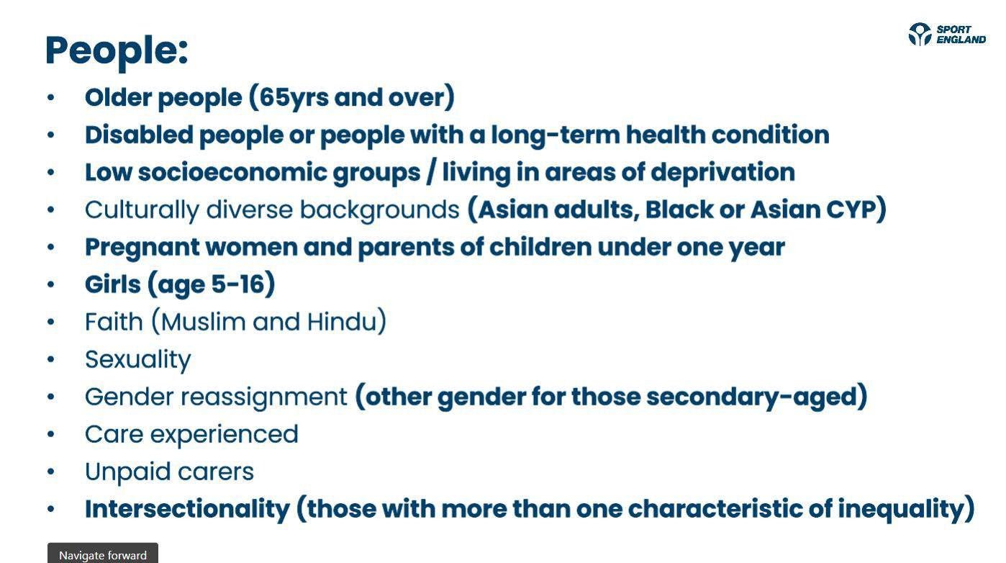

beactivebeds.co.uk | @beactivebeds

Slide 39
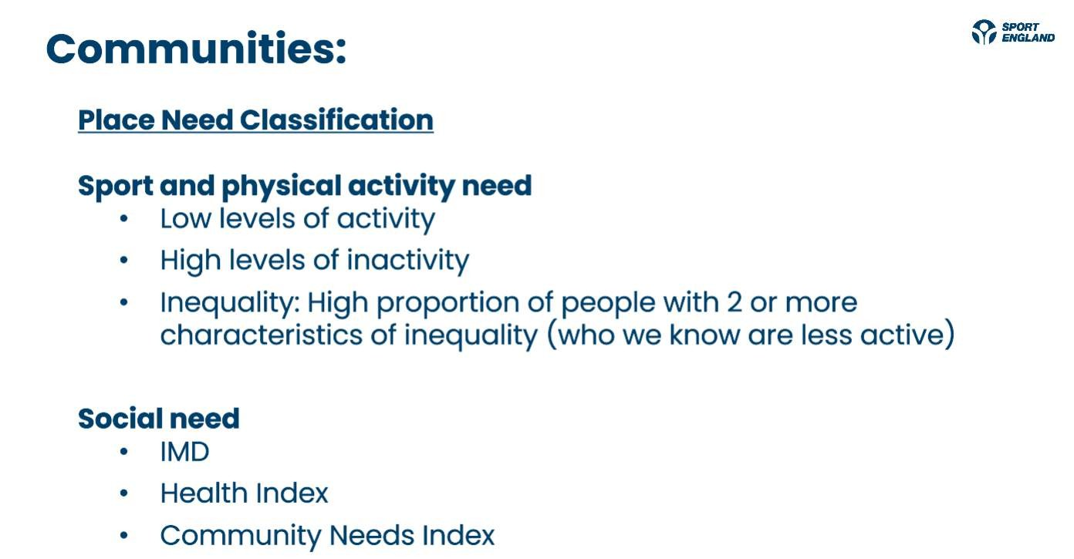
beactivebeds.co.uk | @beactivebeds

Slide 40


Activity Finder
https://www.playwaze.com/Dis
cover/Bedford%20Bedfordshire
%20Bedford%20England
beactivebeds.co.uk | @beactivebeds

Slide 41

Moving Forward Together
We are committed to working with
like-minded organisations and people
who are also passionate about
tackling inequalities and are driven by
having a profound impact on the lives
of those in our communities that have the least opportunities.
Contact:
James Timmins
Health & Inequalities Officer
james@beactivebeds.co.uk
beactivebeds.co.uk | @beactivebeds

Slide 42

Q&A
beactivebeds.co.uk | @beactivebeds

Slide 43

beactivebeds.co.uk | @beactivebeds

Slide 44

Inspiring Bedfordshire to move more
Thank you
beactivebeds.co.uk | @beactivebeds

