Slide 1
Green Social Prescribing
in Bedfordshire
Nicola Scholfield, Beds RCC
Beds Mental Health Alliance, 14th May 2024

Slide 2
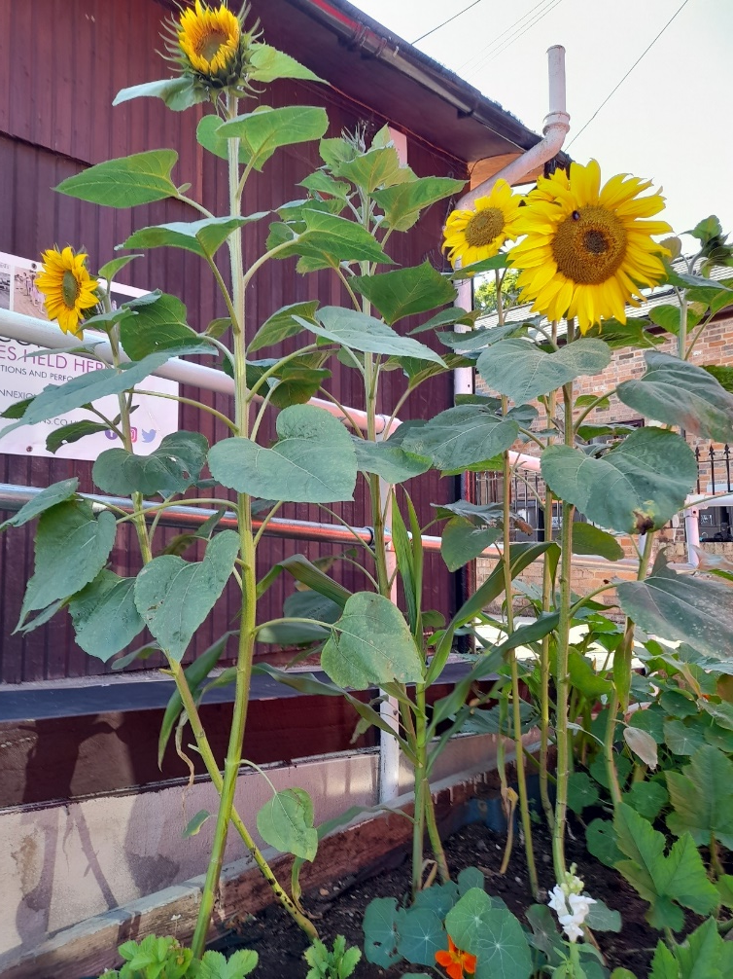
Green Social Prescribing – evidence-based
“Nature-based social prescriptions can benefit long term health and wellbeing, particularly life satisfaction and happiness”: https://socialprescribingacademy.org.uk/read-the-evidence/nature/
Participating in nature-based activity can:
Encourage us to be more physically and active
Improve our connections with others
Provide purpose and sense of community
Notice our surroundings and be mindful in the moment
Provide opportunities to learn

Slide 3
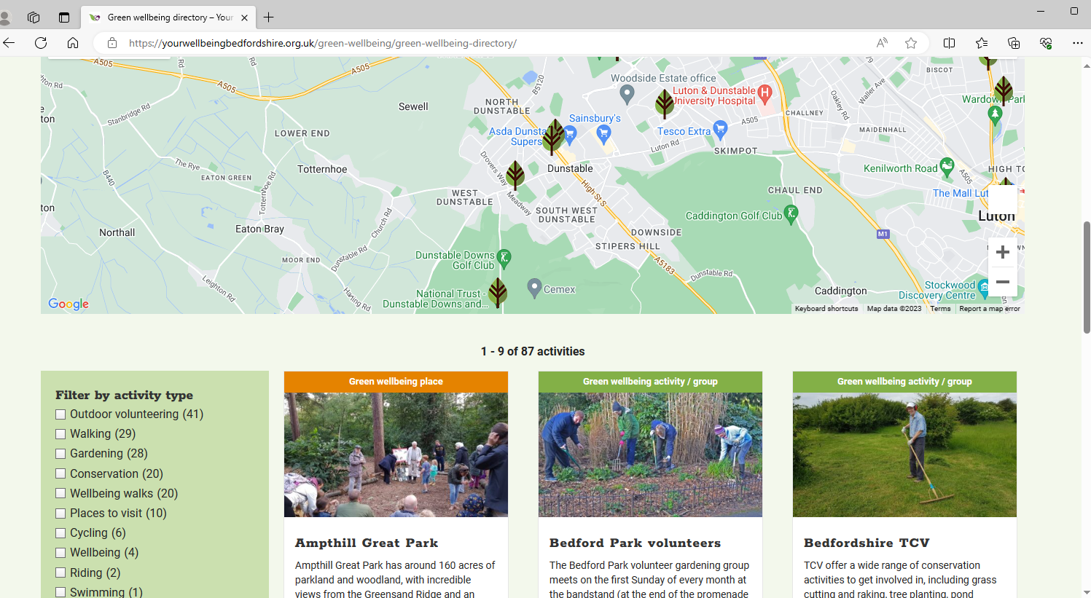
Beds RCC’s Green Social Prescribing Programme
1 | Making connections and building capacity
2 | Development of Beds RCC assets for GSP
3 | Creation of targeted offers in partnership
Green Wellbeing Directory – over 90 groups that meet regularly outside in Bedfordshire

Slide 4
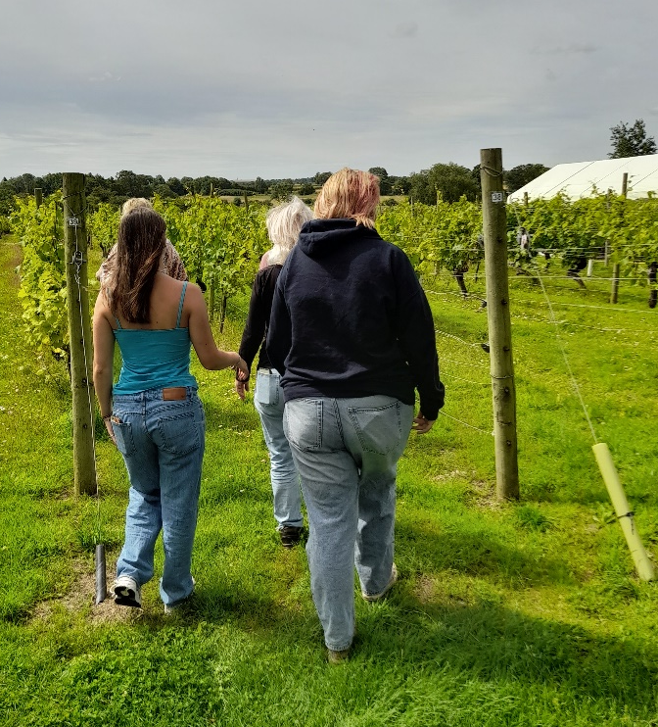
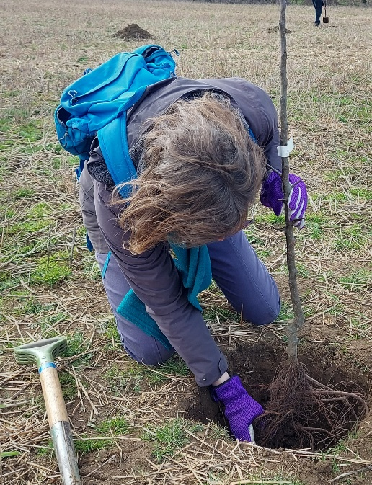
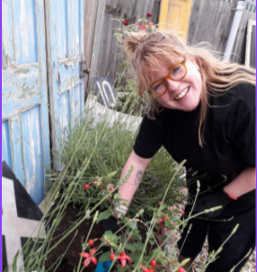
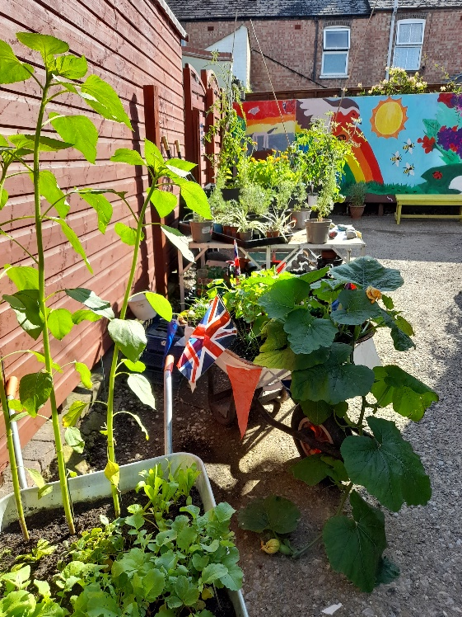
Green Social Prescribing through Beds RCC assets
Roots to Rails - Ridgmont Heritage Centre
Dunstable Community Halls
Ivel Valley Conservation Wellbeing Group
Wellbeing @ The Vineyard

Slide 5
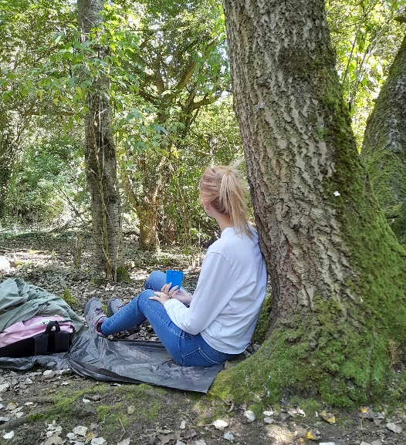
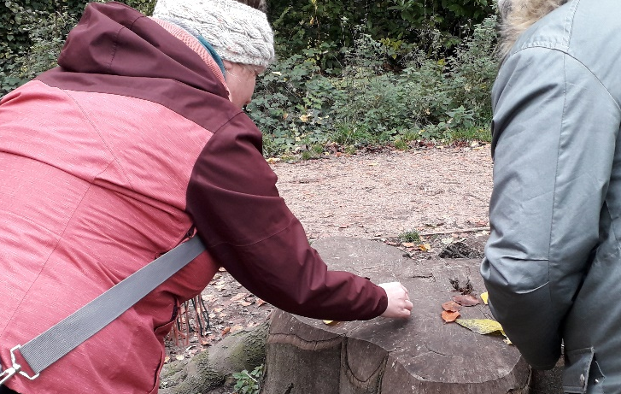
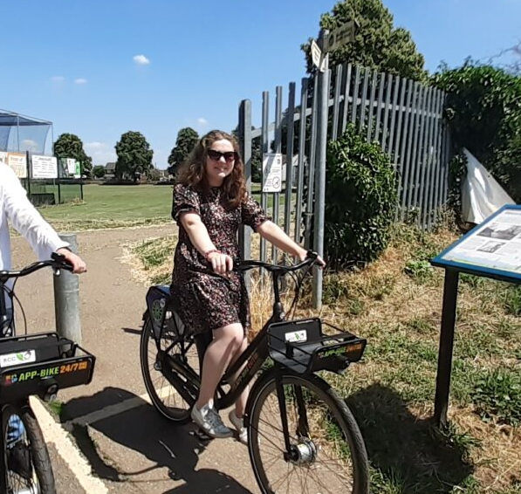
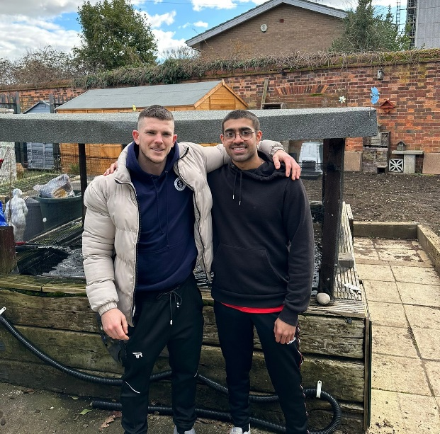
Unlocking the benefits of our green spaces
BigglesBike to explore the Green Wheel
MEET: Men, Engage, Exercise, Talk
Natural Mindfulness
Walks
Nature Connection sessions

Slide 6
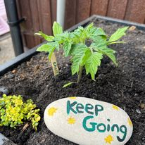
Does it make a difference? Yes ☺
“The group has had a positive impact on my mental health, as it has helped hugely in bringing me out of my shell and becoming confident again after my injury. It has helped me become more positive in my outlook on life and of my future.”
IVCV Wellbeing Group participant, 2023
“Coming here has been major in terms of my mental health. I look forward to coming here and I notice it has a negative impact on me if I’m unable to come.”
Dunstable Community Halls Garden participant, 2023

Slide 7
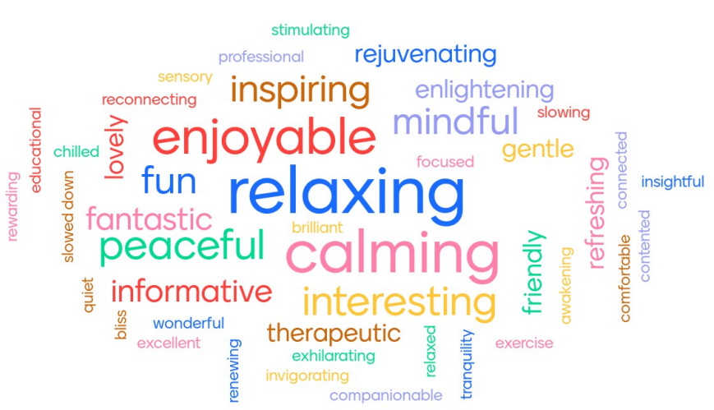
We asked our participants for 3 words to describe a Green Wellbeing session..

Slide 8
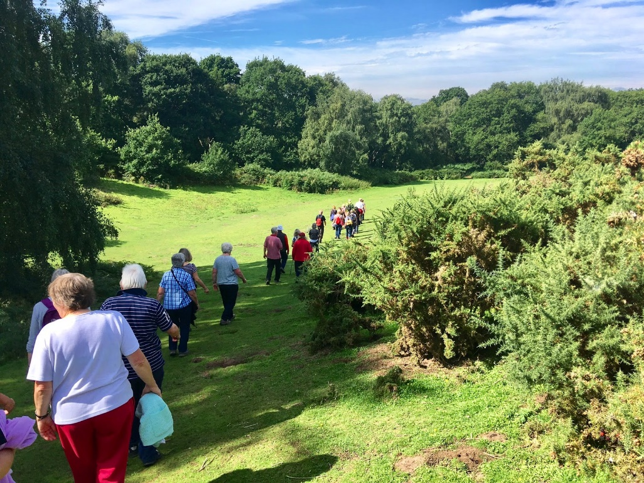
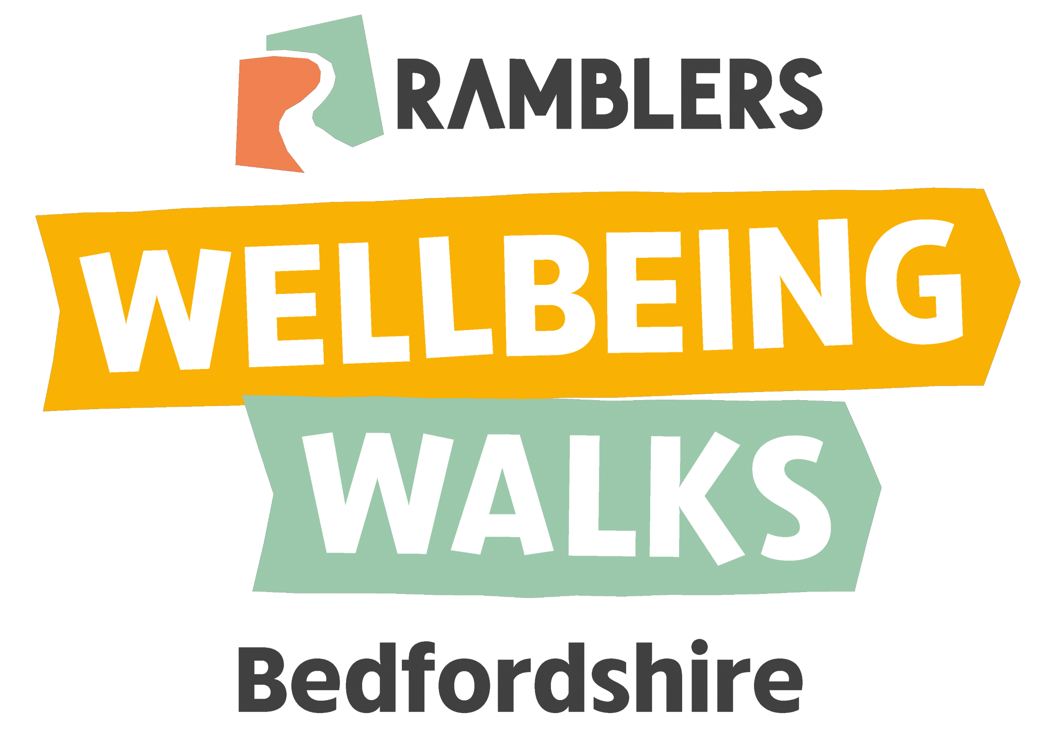
Wellbeing Walks
We support over 30 walks across Bedfordshire each week
96% said the Wellbeing Walks has helped to support their physical health.
97% said the Wellbeing Walks have helped them to develop friendships
88% said the Wellbeing Walks have encouraged them to be more active.
76% said that joining the Wellbeing Walks has helped to support their mental health.

Slide 9
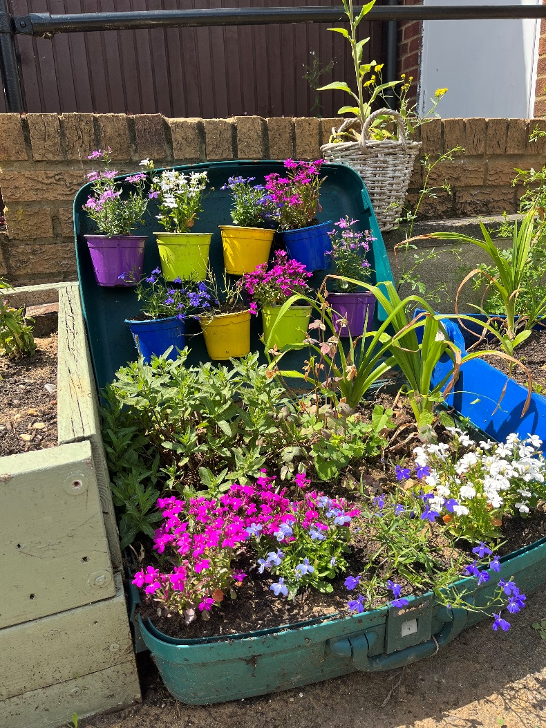
New for 2024..
Home–based Green Social Prescribing
Nature Buddies
Targeted offers

Slide 10

Thank you
For more information, go to:
https://yourwellbeingbedfordshire.org.uk/green-wellbeing/
Or contact me: nicola.scholfield@bedsrcc.org.uk

